Slide 1
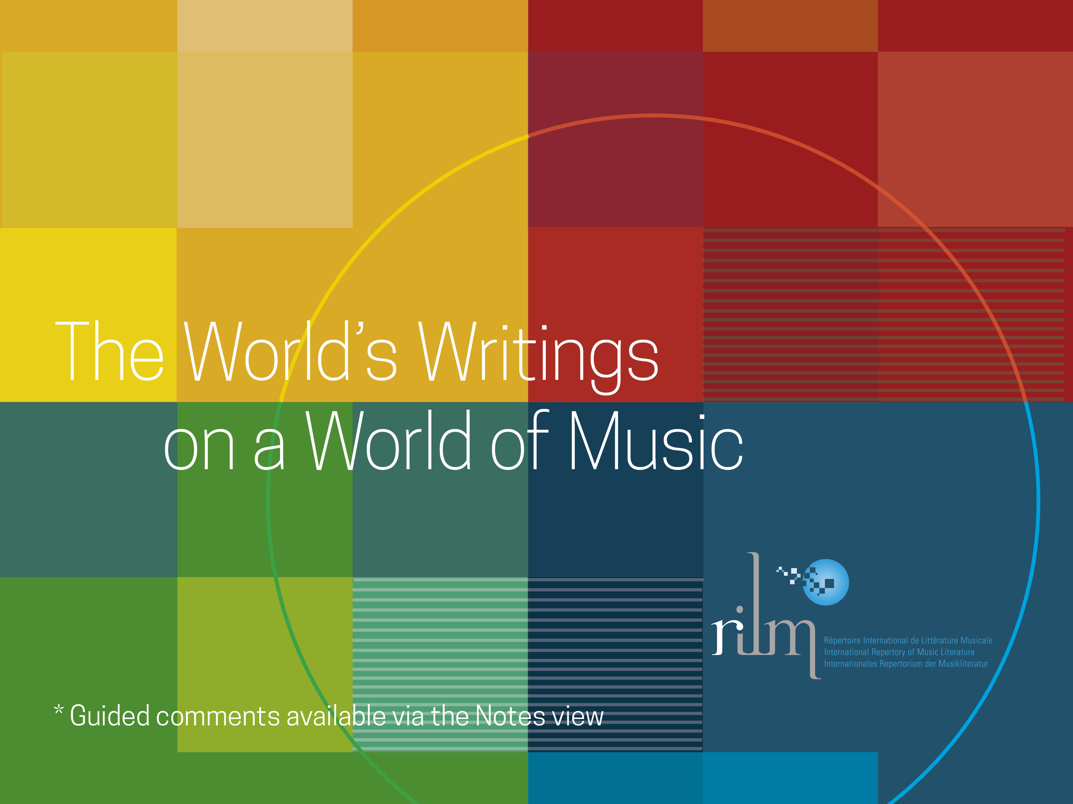
Notes:
RILM provides all-encompassing access to music literature from around the world. This goes along with RILM’s mission to document and disseminate music research worldwide, with a commitment to the comprehensive and accurate representation of music scholarship in all countries and languages, and across all disciplinary and cultural boundaries.

Slide 2
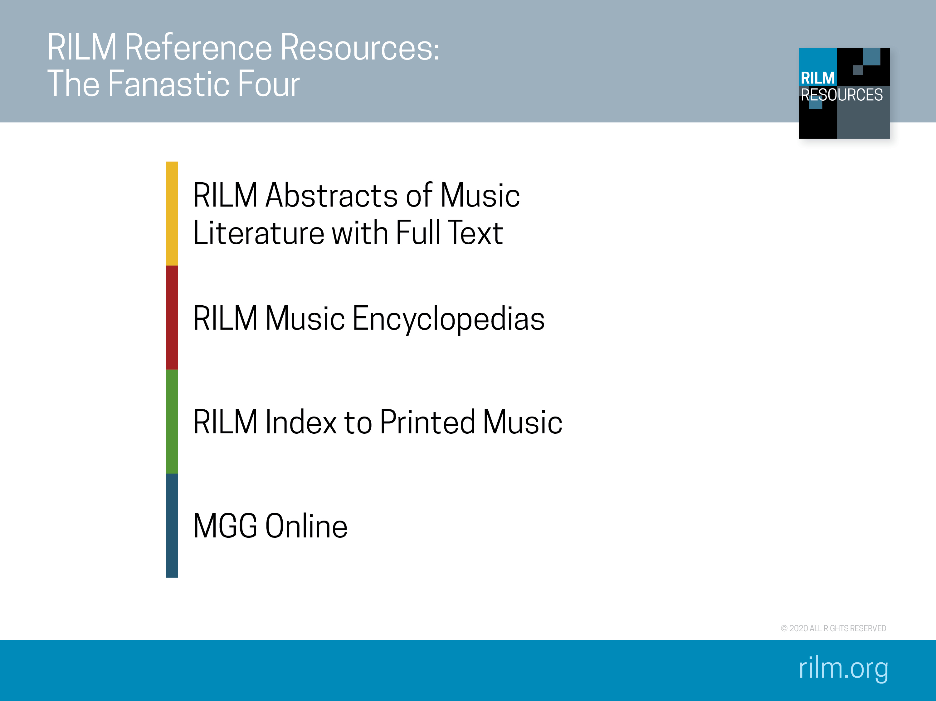
Notes:
For the first 50 years of RILM’s existence, the fulfillment of this mission focused entirely on RILM Abstracts of Music Literature. Then RILM’s focus expanded to encompass full-text projects, which are part of the Fantastic Four:
RILM Abstracts of Music Literature with Full Text (RAFT)
RILM Music Encyclopedias (RME)
RILM Index to Printed Music (IPM)
MGG Online

Slide 3
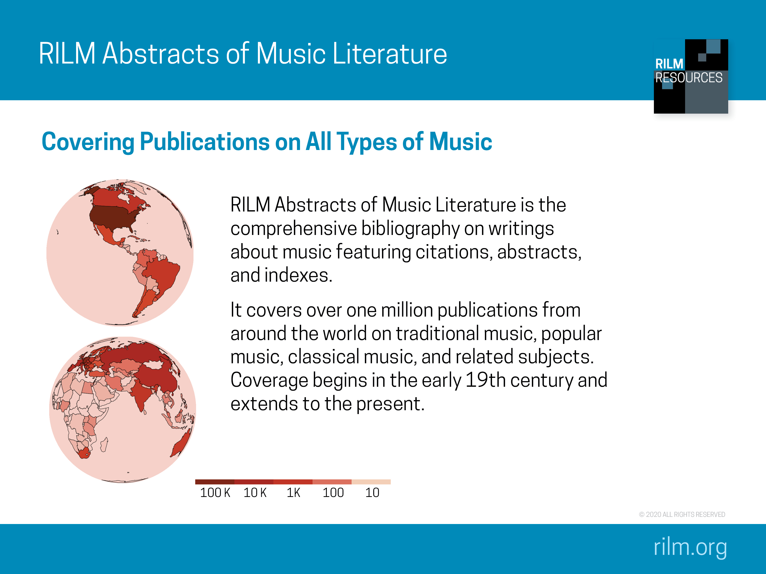
Notes:
RILM Abstracts of Music Literature abstracts and indexes significant writings about music from all over the world. RILM currently contains over 1 million records, in over 140 languages, from about 180 countries. The darker the red color on the globe, the more records we have to offer for that country.
And even if you cannot read the language of the item, you can get a sense of the content as every bibliographic record contains an English translation of the title and often a summary of the content in English. We also provide abstracts in the original language whenever possible. Records for publications issued in non-Roman languages are displayed in both the original language and English. We are currently focusing on remedying the lacuna of information from Africa and Asia.

Slide 4
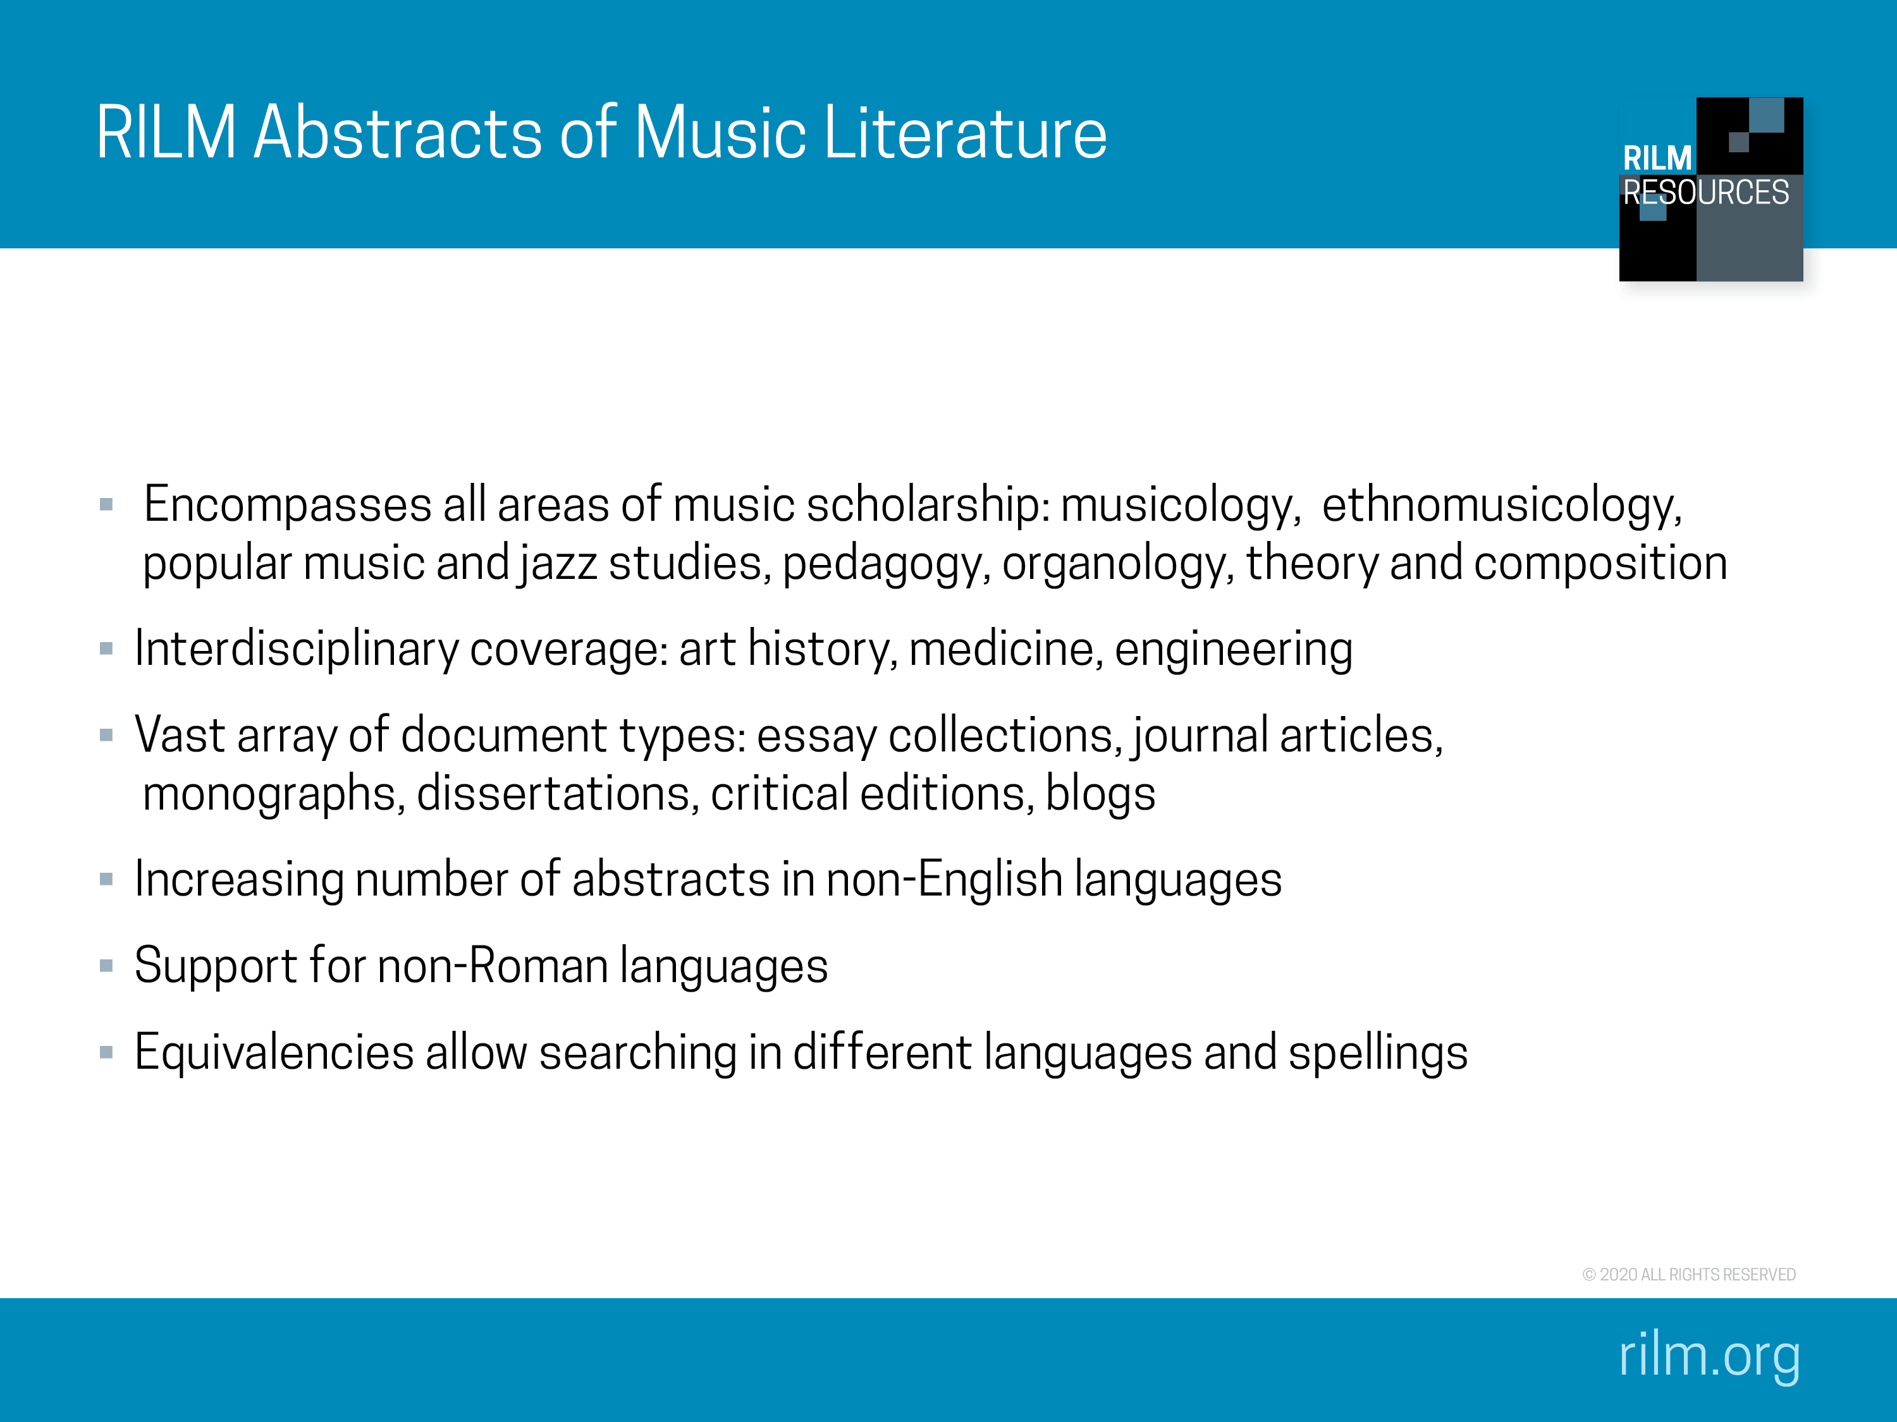
Notes:
RILM Abstracts of Music Literature covers all areas of music scholarship, while also aiming for strong interdisciplinary coverage, i.e. research in disciplines ranging from art history to therapy to engineering.
RILM’s records cover a vast range of document types, from journals and monographs to blogs and fan zines.

Slide 5
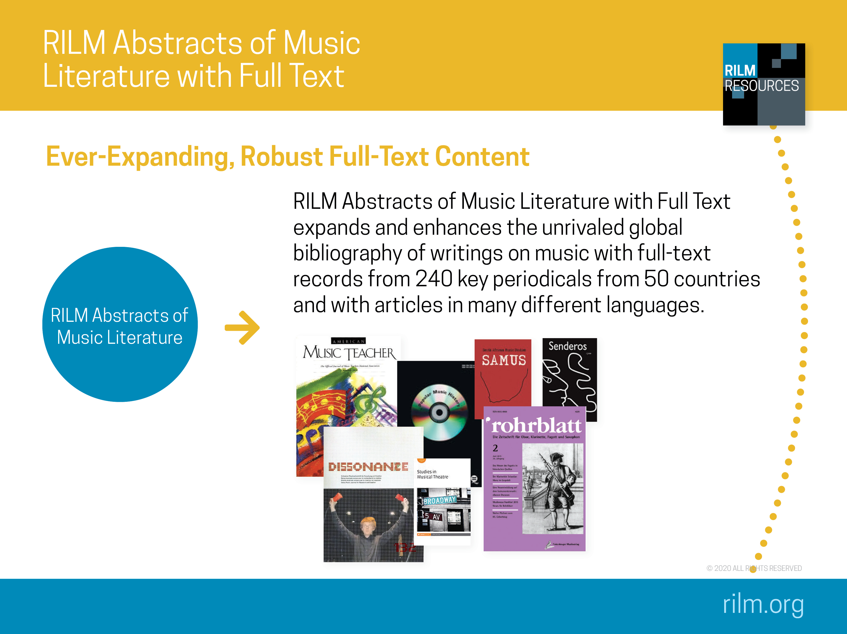
Notes:
RILM Abstracts with Full Text consists of the full RILM Abstracts plus the actual content of full-text journals. If you want to see a list of all journals included in full text, go to rilm.org/fulltext.

Slide 6
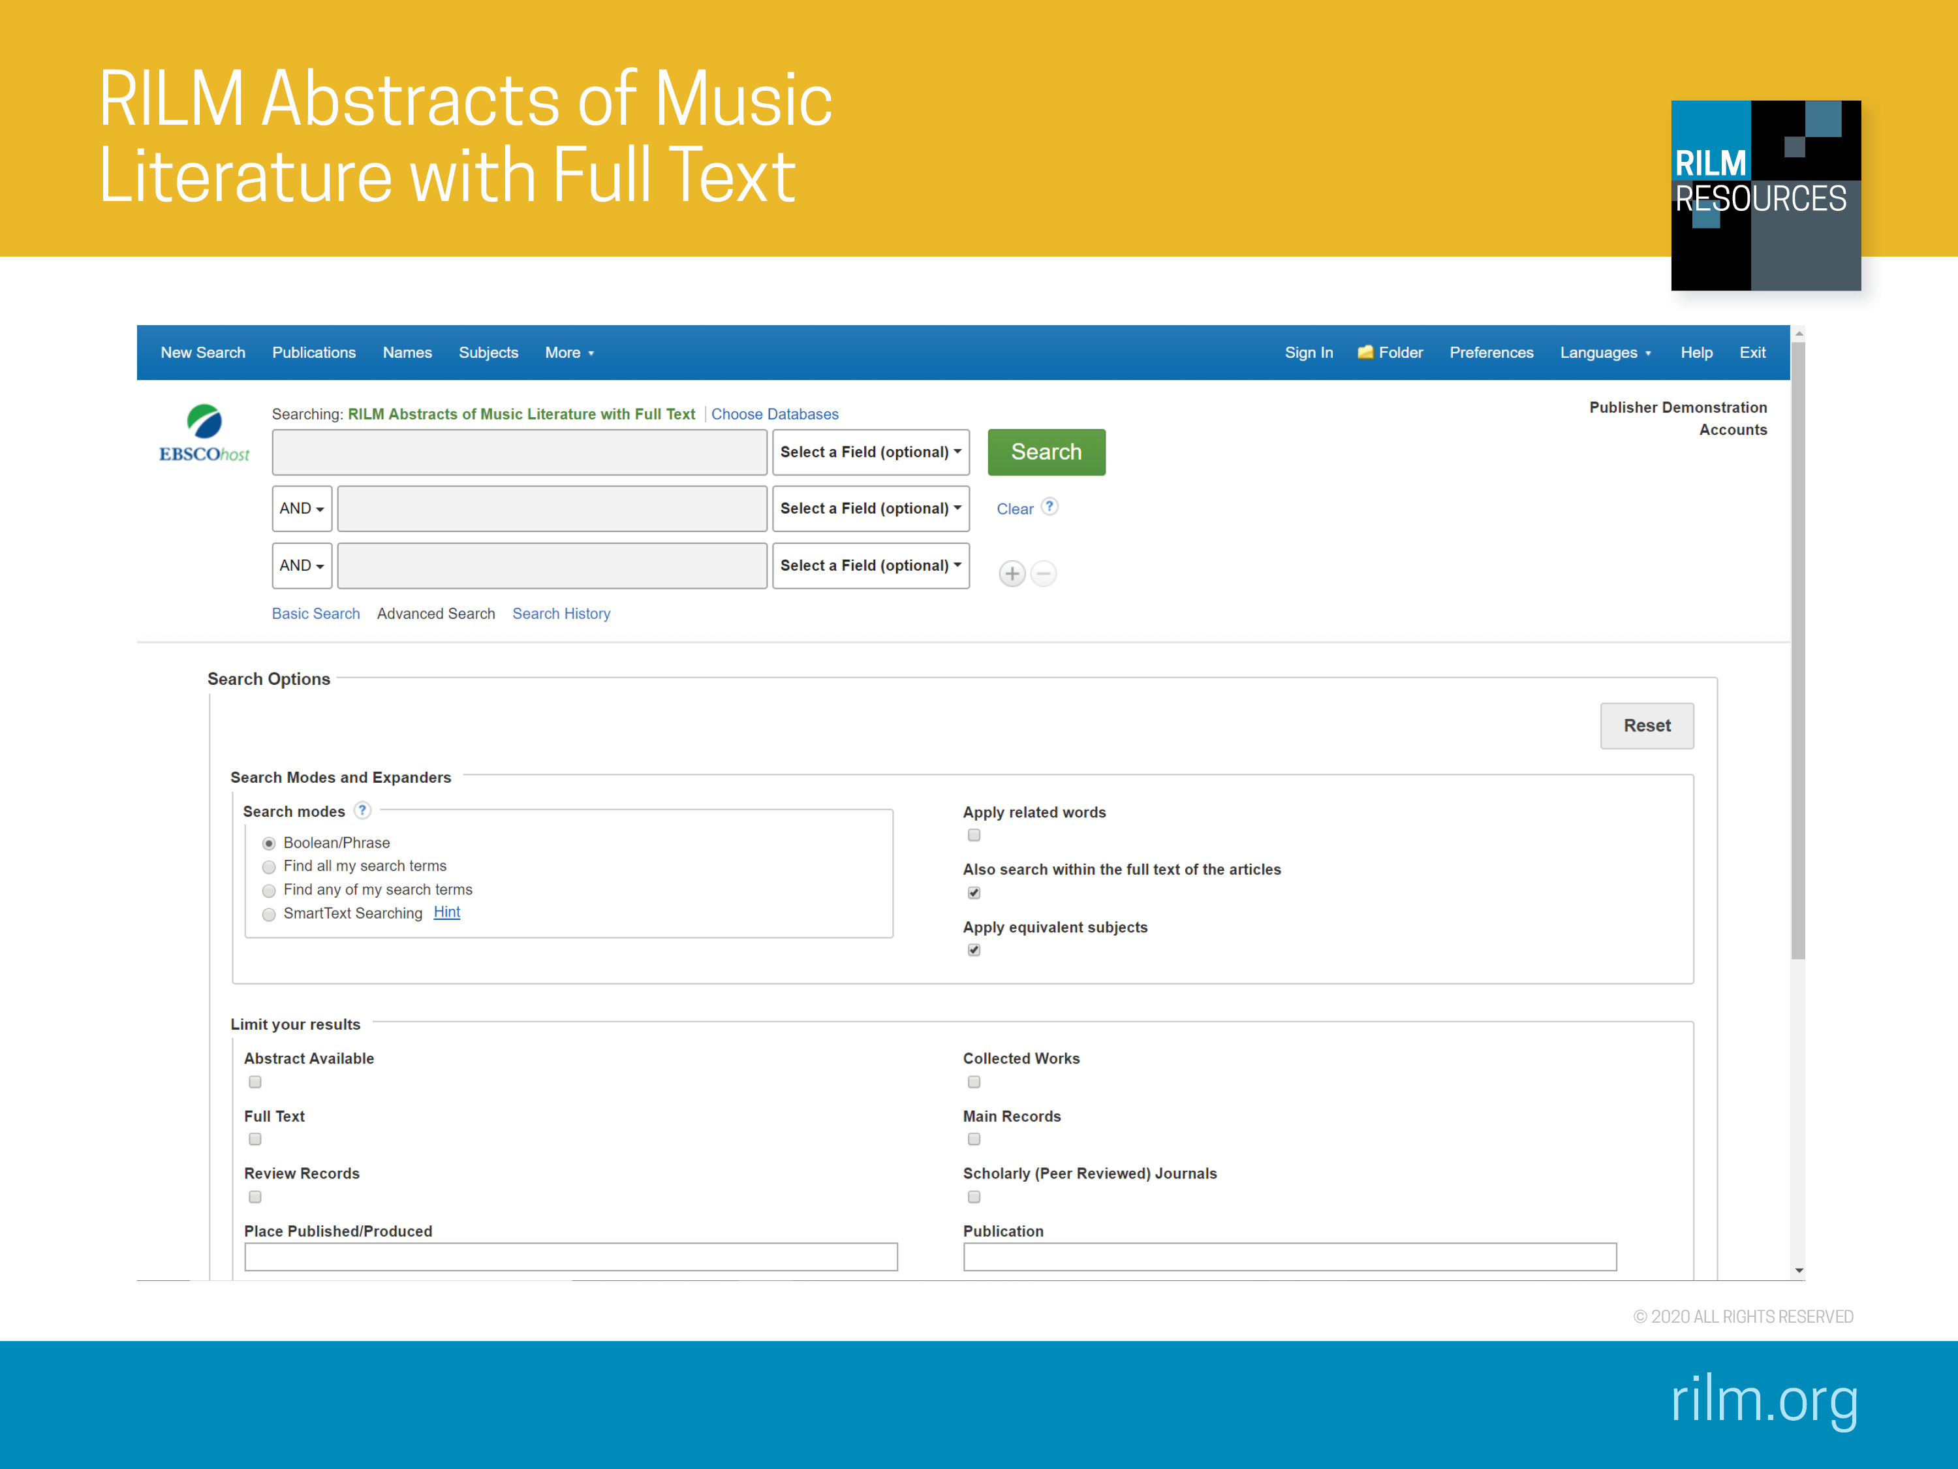
Notes:
Recommended Searches on EBSCOhost
1. Search terms: therapy, tango
Launch a basic search on therapy and tango
As this is a more narrow search, you will receive just over a dozen results, two of them are “Intensive tango dance program for people with self-referred affective symptoms” by Rosa Pinniger et al. (Music and medicine: An interdisciplinary journal 5/1 [January 2013] 15–22) and “Emotional and neurohumoral responses to dancing tango argentino: The effects of music and partner” by Cynthia Quiroga Murcia (Music and medicine: An interdisciplinary journal 1, no. 1 [July 2009] 14–21). Their research suggests that tango dancers showed significant reductions in depression, anxiety, stress, and insomnia at posttest relative to the controls; and that motion with a partner to music has more positive effects on emotional state than motion without music or without a partner. The article “Improvising in styles: A workbook for music therapists, educators, and musicians” by Simon Gilbertson (Canadian journal of music therapy/Revue canadienne de musicothérapie 17/1 [2011] 107–11) can be read immediately as the journal is part of the RILM Abstracts with Full Text.
Why is this search important? RILM Abstracts is highly useful also for cross-disciplinary searches, in this case traversing the discipline of medicine. We have about 5000 records on medicine (far over 100 appear in conjunction with Beethoven). More specifically on therapy, RILM counts over 400 records on therapy for the elderly; over 600 records for rehabilitation. If narrowed down to English publications only, there are over 200 studies on cancer and therapy; and over 500 on therapy and autism.
2. Search terms: India, dance, pedagogy
Launch a basic search on India and dance
This is a very broad search, given that India is a central subject in ethnomusicology (we distinguish between Karnatak tradition and Hindustani tradition when applicable). It renders over 6100 results—an extraordinarily number given the cross-disciplinary second search-term “dance.” If we would narrow down the search by language, e.g. Hindi or Tamil we would only receive a handful of results. Indeed, around 6000 records are in English. To narrow down further add pedagogy as another search term (we classify and index pedagogy very thoroughly). Among the over 90 search results, 42 are available in full text.
Why is this search important? RILM offers a broad variety of subjects in various fields, here specifically ethnomusicology, dance studies and pedagogy. Many journal articles are now available in full text so that researcher can access them instantly. But more so, more eclectic keyword searches such as the “morin huur” can now render results even if RILM does not index such terms as the PDFs are included in the searches as well (RILM counts some 40 results for the Mongolian string instrument, taking into account the following equivalent terms: morin khuur and matouqin)
3. Search terms: hip hop and copyright
Launch a basic subject search on hip hop. A proud 5000 results
Why is this search important? It shows our coverage in the area of popular music, and also its diversity of document types (look at source types and note the diversity, among them results from fanzines (we occasionally also includes blog entries if important as research material), though academic publications prevail, see for example the over 1300 results from academic articles.
Now limit the search by search term copyright
The search currently returns over 80 results. Two of them are “How copyright effected the musical style and critical reception of sample-based hip-hop” (Journal of popular music studies 26/2–3 [June–September 2014] 295–320) by Amanda Sewell, and “’This is a sampling sport’: Digital sampling, rap music, and the law in cultural production” (Murray Forman, ed., That’s the joint! The hip-hop studies reader [2004] 443–58) by Thomas G. Schumacher. Both articles focus on the intersection of technology, law, and music in the context of intellectual property law and hip hop. The first looks at how hip-hop artists have responded to court rulings that have made digital sampling prohibitively expensive or simply impossible in many cases, adapting new creative processes to work around these imposed limitations. The second article “isolates copyright law as yet another site in which rap's creative approaches have disrupted the prevailing order, necessitating a reconsideration of the ways that law and culture are linked and the implications of their relations” (quoted from the abstract).
Why is this search important? It gives unique insight into cross-disciplinary subjects. In this example, the chosen search terms open a window on the ever-evolving relationship between popular music, digital technology, creative practice, the music industry, and the legal field. Digital media have upended legal standards across many industries with popular music often serving as the legalistic canary in the coalmine. At the turn of the century, it was online-music-trading service Napster that kicked off a series of legal battles that continue to this day. The two records above demonstrate both how technology has reshaped the law, and how legal standards can influence music making, impacting musical aesthetics and economics. Popular music has continually been at the forefront of these developments, anticipating new creative methods and new methods of doing business, across a broader spectrum of mass media and expressive forms.
4. Search terms: “sexuality and gender,” “popular music,” and “wars and catastrophes”
Launch a basic subject search on these three terms
The search currently returns over 40 results. Titles include “Finding meaning in manhood after the war: Gender and the warrior myth in Springsteen’s Vietnam War songs” (Jerry Zolton, et al., eds., Bruce Springsteen, cultural studies, and the runaway American dream [Ashgate Studies, 2012] 111–22) by Heather Stur, “Sonic contagions: Bird flu, Bandung, and the queer cartographies of MIA” (Journal of popular music studies 26/2-3 [June-September 2014] 226–50) by Ronak K. Kapadia, and “Music, lyrics, and cultural tropes in Australian popular songs of the First World War: Two case studies” (Musicology Australia 35/1 [July 2014] 90–105) by Paul Watt. Narrowing the search to full-text items returns three results, two of which are “The ‘other’ as projection screen: Authenticating heroic masculinity in war-themed heavy metal music videos” (Metal music studies 1/3 [2015] 319–40) by Wiebke Kartheus; and a review of the book Victory through harmony: The BBC and popular music in World War II (Oxford University Press, 2012) written by Christina Baade and reviewed in ARSC journal (Fall 2013) 284–86, by Pekka Gronow (the book itself can also be found in RILM). Kartheus article “examines Islamophobia as an undercurrent of U.S. culture, heavy metal’s notions of masculinity and authenticity, and the ways in which these two seemingly separate issues intersect in war-themed music videos.” Baade’s book “both tells the story of the BBC's musical participation in wartime events and explores how popular music and jazz broadcasting helped redefine notions of war, gender, race, class, and nationality in wartime Britain” (from author and publisher abstracts, respectively).
Why is this search important? A growing body of research demonstrates that gender roles are nowhere more prominent than in war. This is especially true when it comes to cultural representations of warfare and warriors—which often seem to be as much or more about ideal gender roles than warfare itself—representations that greatly impact public opinion and official policy on military conflict. However, most of this research has overlooked the role of music in these representations of war. Popular music can be a powerful medium in this context, especially given the central role it has often played in interpreting and performing gender over the past century—arguably with more nuance and influence that any other expressive form during this time. The RILM search above shows there is a sizeable body of research on the intersection of warfare, gender, and popular music that could provide additional insights to sociologists and military scientists.
Other solid search terms to explore on your own are Aboriginal, pedagogy and Bologna, graffiti, cultural studies. Further searches for regional representation upon request.
If you need customized searches for your classroom, please contact tfruhauf@rilm.org.

Slide 7
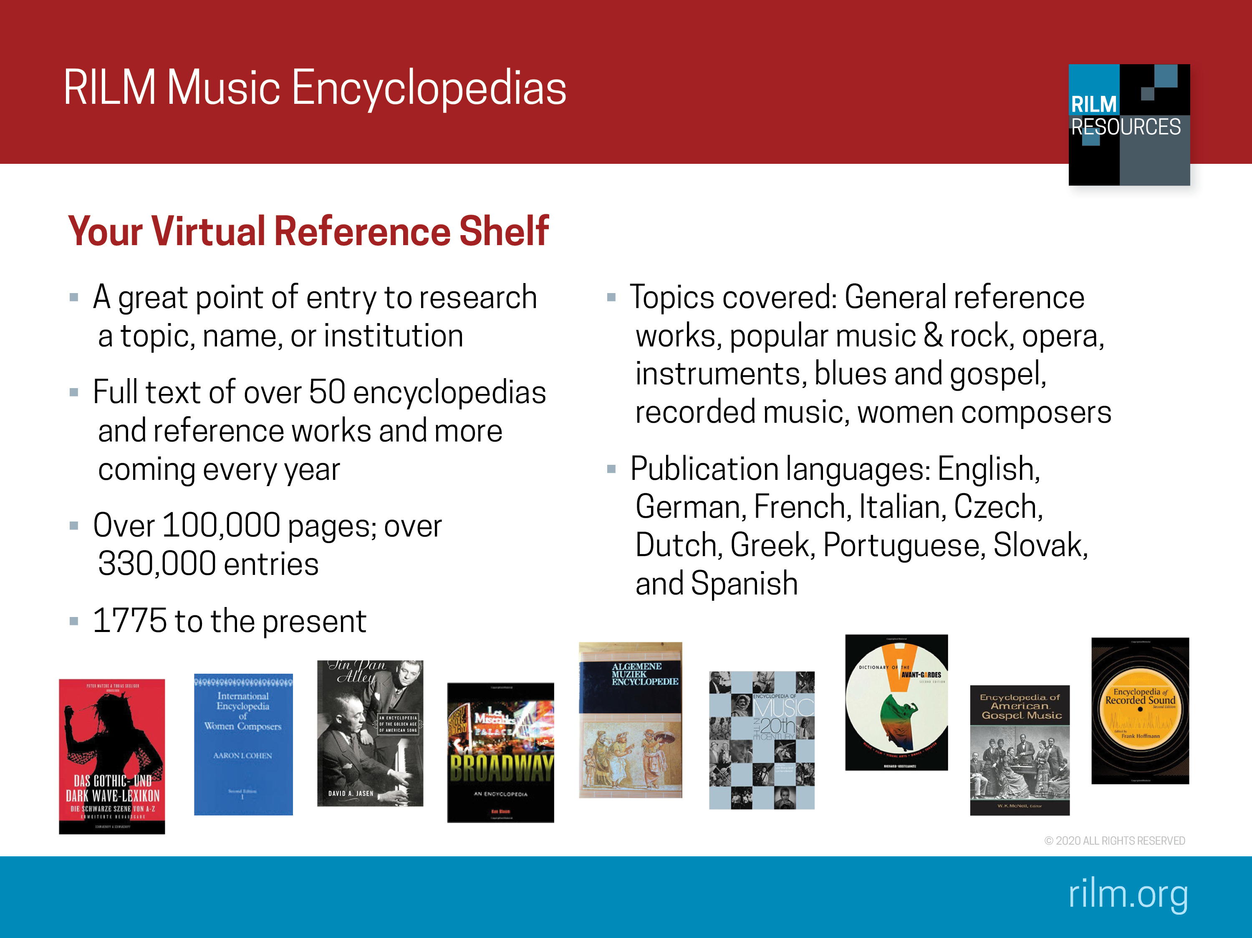
Notes:
RILM Music Encyclopedias is an annually expanding full-text compilation of reference works that can be searched on one click. When it was launched, the collection included 41 encyclopedias and dictionaries of music. Every year, we add new titles. Our encyclopedias cover a vast range of topics, from opera to marching bands to blues and gospel, and our collection includes publications in many different languages and published from 1775 to the present. For a full title list go to: http://www.rilm.org/encyclopedias/

Slide 8
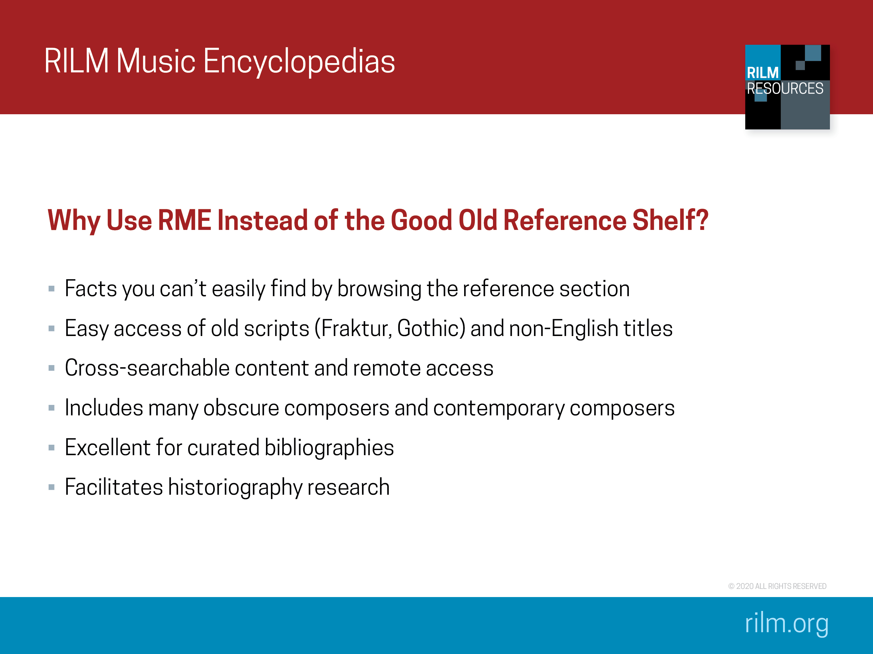
Notes:
RILM Music Encyclopedias is invaluable in finding hard-to-locate content and for multiple other reasons as listed.

Slide 9
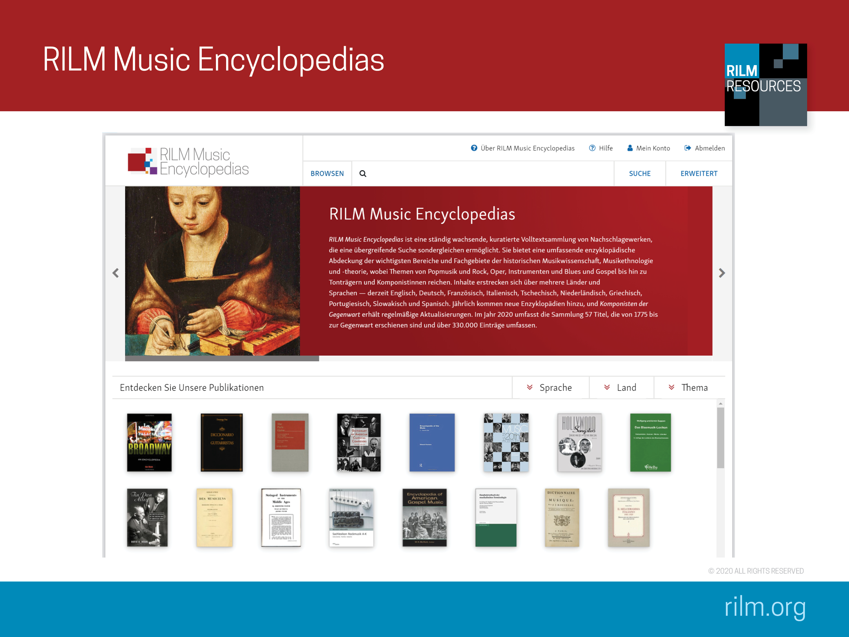
Notes:
Recommended Searches on rme.rilm.org
1. Search term: harpsichord
Launch a basic search on harpsichord
Peruse the first ten search results: you see the entries Harpsichord, Clavecin, Cembalo, Klavier, Steertstück, Gravicembŏlo—all equivalencies for harpsichord
Why is this search important: RME can be searched by musicologists in different languages as it includes equivalencies so that you can search Čajkovskij, Tchaikovsky, Tschaikowsky, etc. and still get you the maximum of search results possible.
2. Search term: Mozart
Launch a basic search on Mozart
Then go to the Advanced Search screen and select Geographic Entry.
On the result list you will find the entry “The Middle East”, by Jane Prendergast, Encyclopedia of Music in the 20th Century. Here you find out that "Fairuz had a wide repertoire including Mozart, flamenco, Balkan folklore and Latin American rumbas."
Why is this search important: This knowledge is crucial for an ethnomusicologist working on Fairuz (“the most widely admired and deeply respected living singers in the Arab world world,” per Wikipedia) and a historical musicologist working on Mozart reception in the Middle East, yet they would never find it by going to the shelf and looking through the hard copy, as it is not indexed. RME cleary has a functionality that a book shelf cannot offer.
3. Search term: Klaus Huber
Launch a basic search on Klaus Huber
The first few search results are name entries for the composer born in 1924 in Switzerland
Why is this search important: RME contains an ongoing, continuously updated encyclopedia, the Komponisten der Gegenwart. His particular entry has been updated just in 2015. This is especially valuable for living composers. But how at a given time has a composer been presented and perceived. This search also shows the merits of RME for historiographic research, as the music researcher can easily compare the 2015 Komponisten der Gegenwart entry with the 1981 entry in Algemene muziek encyclopedie and the 1993 entry in Dictionnaire de la musique: Les hommes et leurs œuvres. This makes all titles valuable. Currency and depth of content are pertinent to RME.
If you need customized searches for your classroom, please contact tfruhauf@rilm.org.

Slide 10
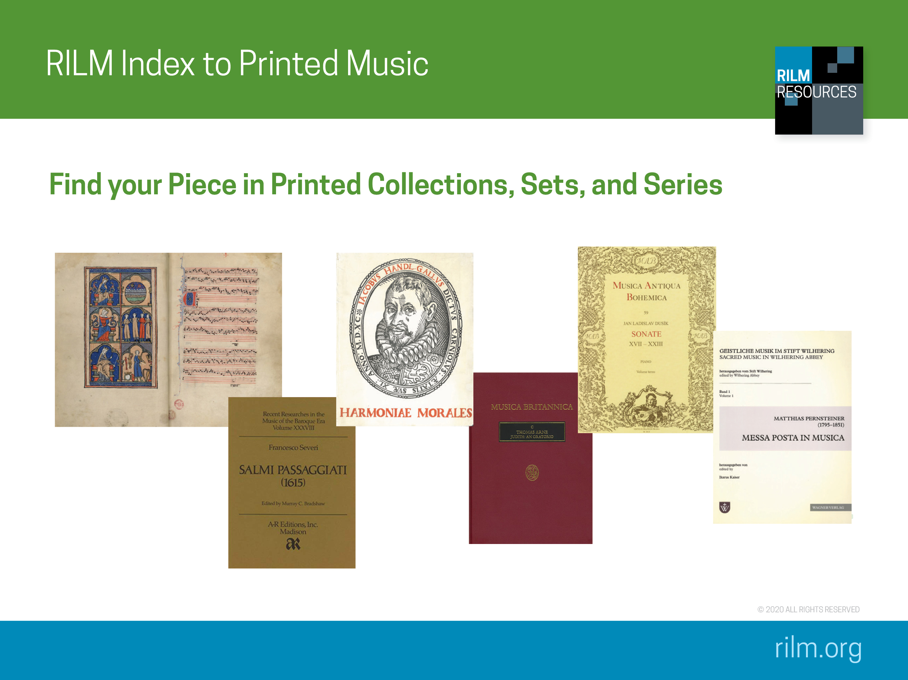
Notes:
RILM’s newest resource is the Index to Printed Music (IPM was founded in the mid-1980s, and RILM took over this resource from its original owner in July 2018).
In case you are not yet familiar with it, the Index to Printed Music indexes individual pieces of music contained in printed collections, sets, and series. Finding those individual pieces within complete editions, monuments, anthologies, or other collections, can be a real challenge, because they may not be indexed separately from their sets or volumes in library catalogues. So the purpose of IPM is to be able to search for and find these individual pieces within authoritative editions. You can search by several different parameters—for example, by work title, genre, performing force, and more. And its very easy to find multiple editions of one work for comparison.

Slide 11
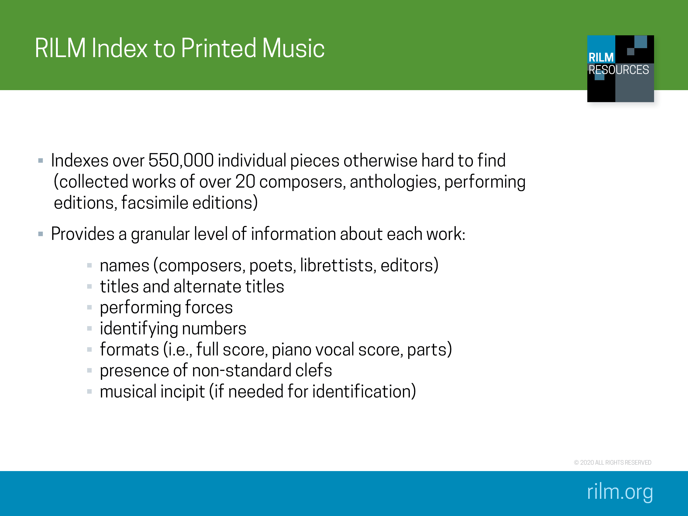
Notes:
Currently, IPM contains records for individual pieces, and over 23,000 volumes of music have been indexed. IPM covers a wide range of editions, including the collected works of composers ranging from Josquin to Janáček, a wide array of historical and geographical sets and series, such as the Denkmäler deutscher Tonkunst and Recent Researches in American Music, anthologies including the Norton Anthology of Western Music, and facsimile editions. (space) Each individual record contains far more information about each work than you are likely to find in a library catalogue.

Slide 12
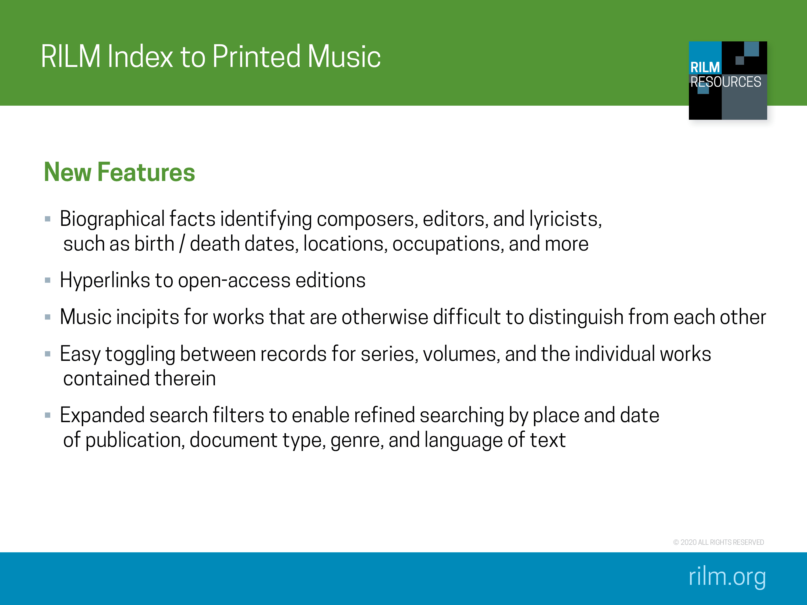
Notes:
The “new” IPM features a number of improvements and new features:
basic data such as birth / death dates, locations, and occupations of composers, editors, and lyricists
records for works that are publicly available online, such as the Neue Mozart Ausgabe, will contain hyperlinks to the open-access edition
records for works that are difficult or impossible to distinguish from each other by means of title or composer will contain music incipits
easy switching from a series record, to records for individual volumes within a series, and then to records for individual works within a volume, and vice versa.
expanded search filters to make it easier to find what you’re looking for.
Recommended Searches on EBSCOhost
1. Florence Price
Search for composer name Florence Price; this brings back over 30 results. Then narrow the search to songs by adding a second filter, genre song. This will shrink search results to 10. Scrolling through this list, you may notice that there are two different records for “Song to the dark virgin”. This is because IPM has indexed two different anthologies that both contain it. Click into one of the records for “Song to the dark virgin” to see full bibliographic information on where to find the song, down to the page number. In addition, this record also provides the genre, language, format of the score, instrumentation, and even the first line of text. Click into the other record for this song and you will notice the publisher is different (other information the same).
2. Adon Olam
IPM has indexed a large number of anthologies dedicated to traditional music of many different cultures. To showcase this, search for one of the most common Jewish hymns, Adon Olam (simply type Adon Olam into the search bar without selecting a field type). This initial search will turn up 70 results, including settings of Adon Olam from a synagogue in Curacao; settings that date from an 18th century Italian Jewish community; and dozens of settings found in Hebräisch­-orientalischer Melodienschatz. Narrow down the search to find any settings by the
composer Salomone Rossi (add a second search term, composer name Salomone Rossi). You will get one result.
This record for Rossi’s setting demonstrates many of the things that IPM does best. You can see at the top of the record that this setting is found in Rossi’s complete works, and the bibliographic information indicates exactly where to find it within the complete works. This record also contains several additional useful bits of information you wouldn’t normally find in a library catalogue record. The genre, language, and incipit are all provided, in addition to instrumentation. Finally, the source note field provides information about the manuscript source for the edition, when available. In this case, it provides a RISM number so you could easily go look up the source in the RISM online catalogue. (opac.rism.info, search A/1 or B/1 number = R 2761; then you can click the “read online” link in the RISM record to get to the full text).

Slide 13
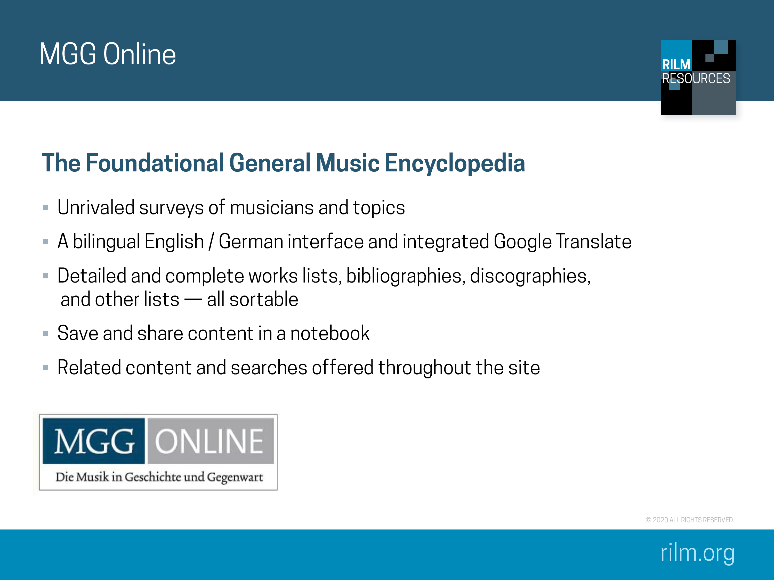
Notes:
[The world-renowned German encyclopedia Die Musik in Geschichte und Gegenwart, was launched online as MGG Online in November 2016. All editorial work is in the competent hands of the Bärenreiter publishing house, just as it was for the print edition; RILM created MGG Online’s platform, known as Egret]
MGG Online contains the second edition of MGG, now updated and revised. That is, in addition to the more than 19,000 articles from the second edition, the content MGG Online is continuously updated, and revisions and entirely new articles are being added on a rolling basis as soon as editorial work is complete on each new entry. There are already hundreds of updated articles, as well as some new entries. MGG Online by authors from countries throughout the world, many of them the foremost experts in their fields. The editorial staff is currently planning many major revisions and new entries per year, and myriad small revisions. All article versions are permanently and easily accessible

Slide 14
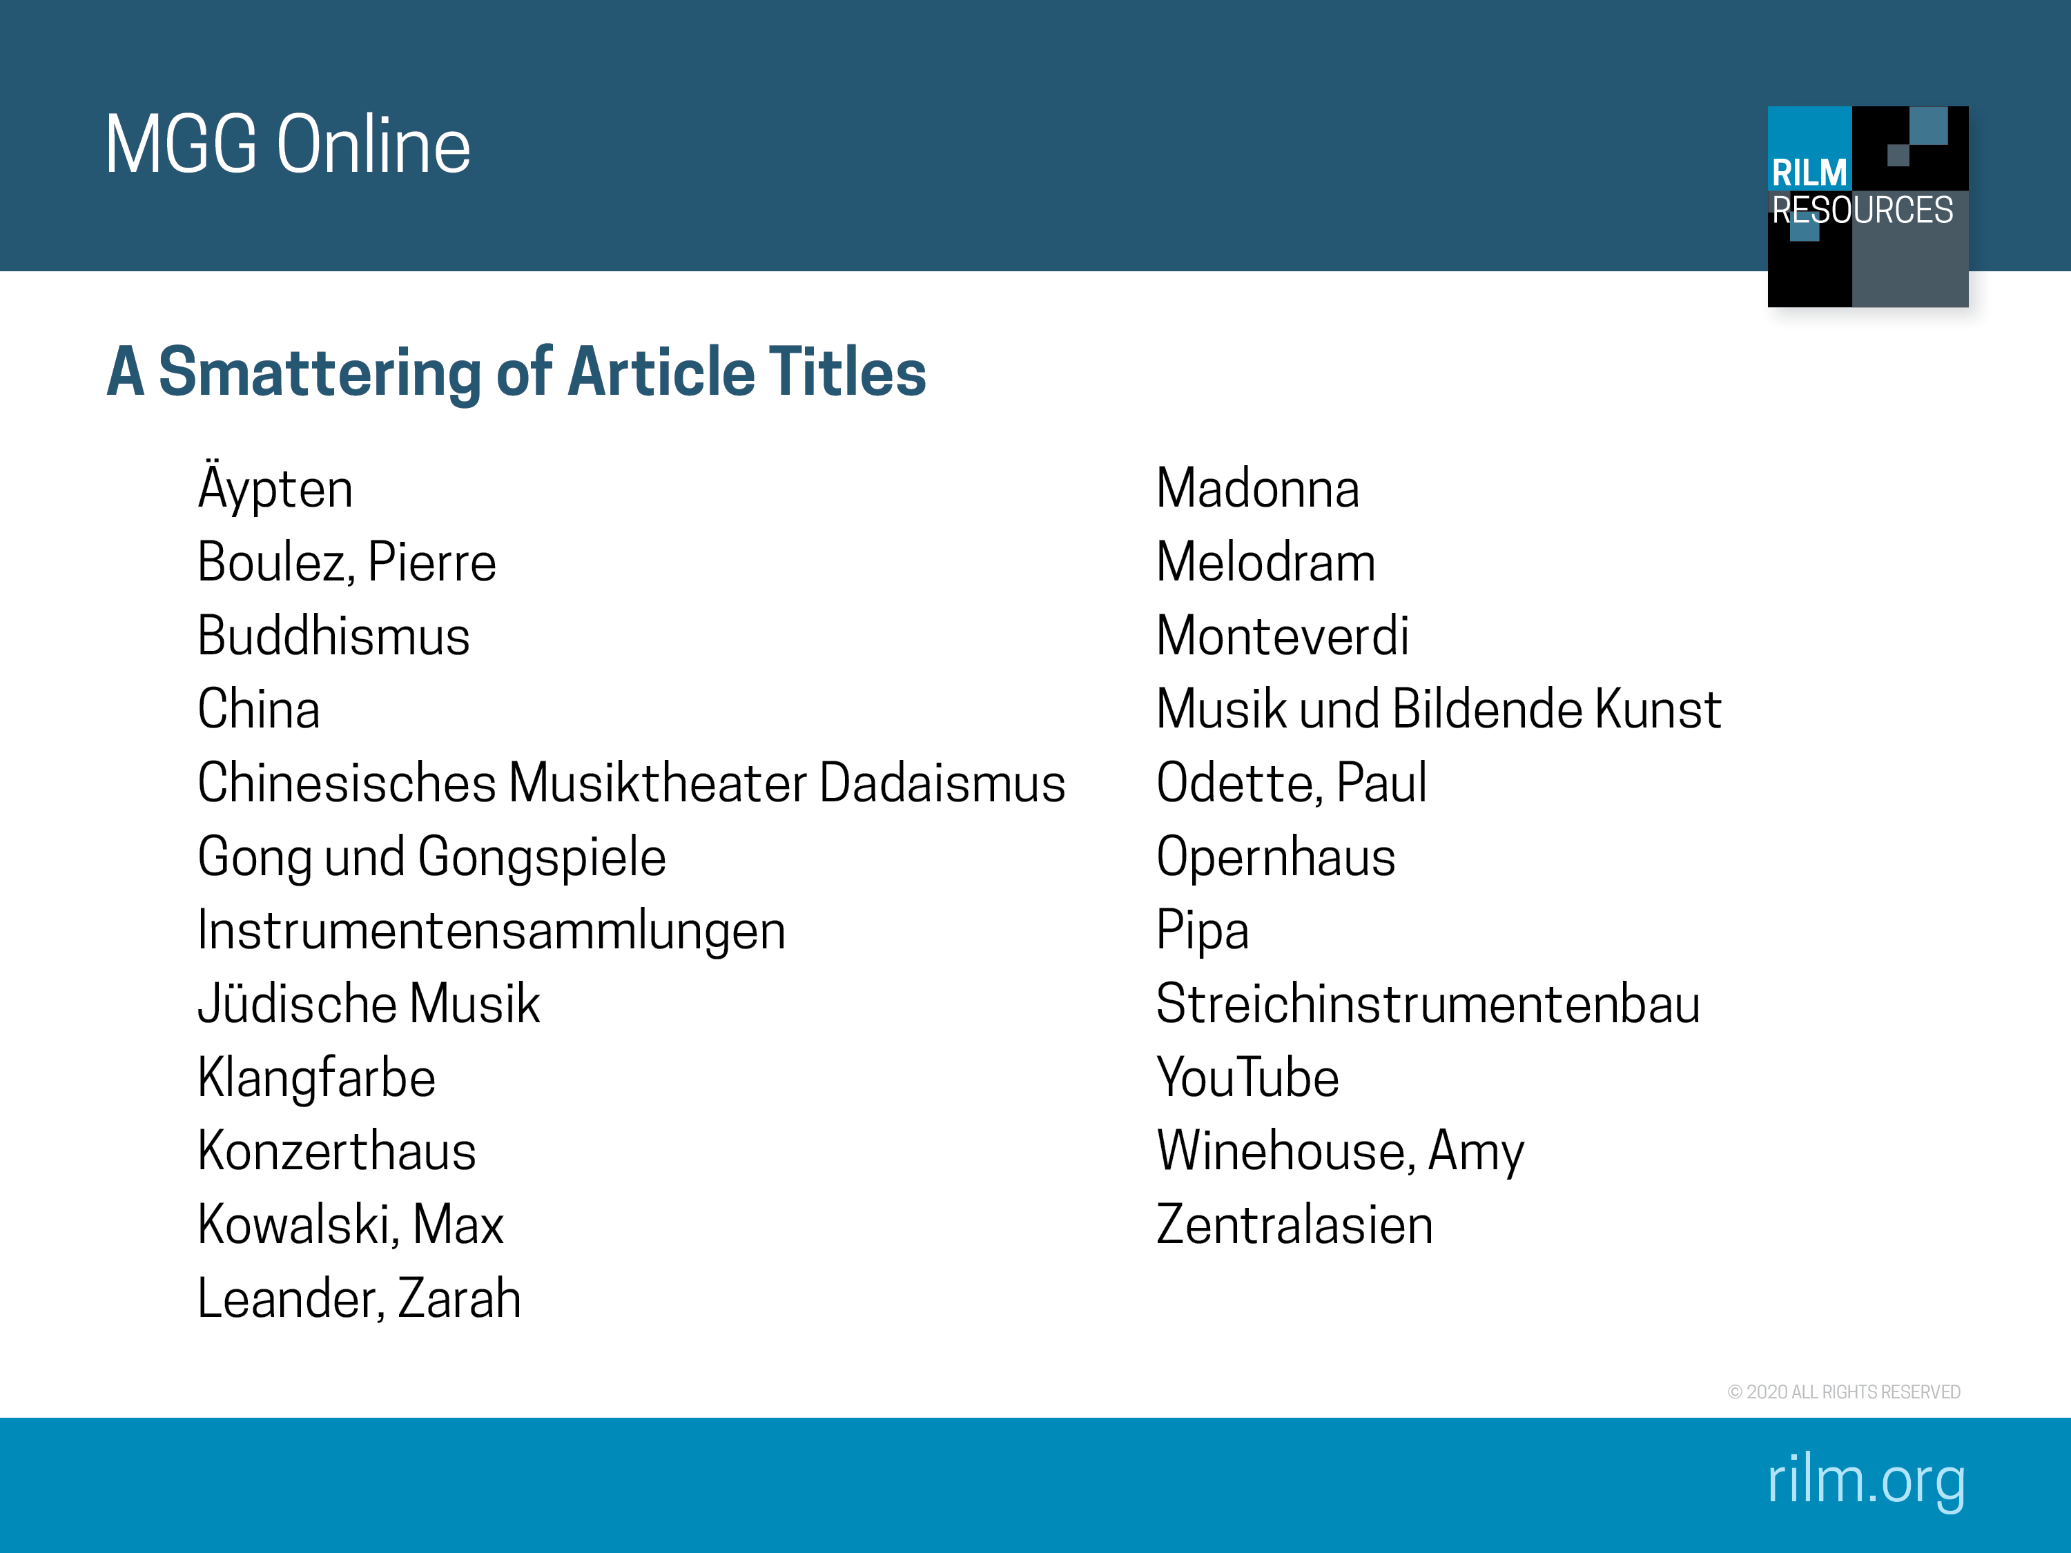
Notes:
Here is a smattering of article titles to show you the breadth of MGG Online. Note the new articles on “YouTube” and “Amy Winehouse”, which may not be the first topics to come to mind, so take a good look!

Slide 15
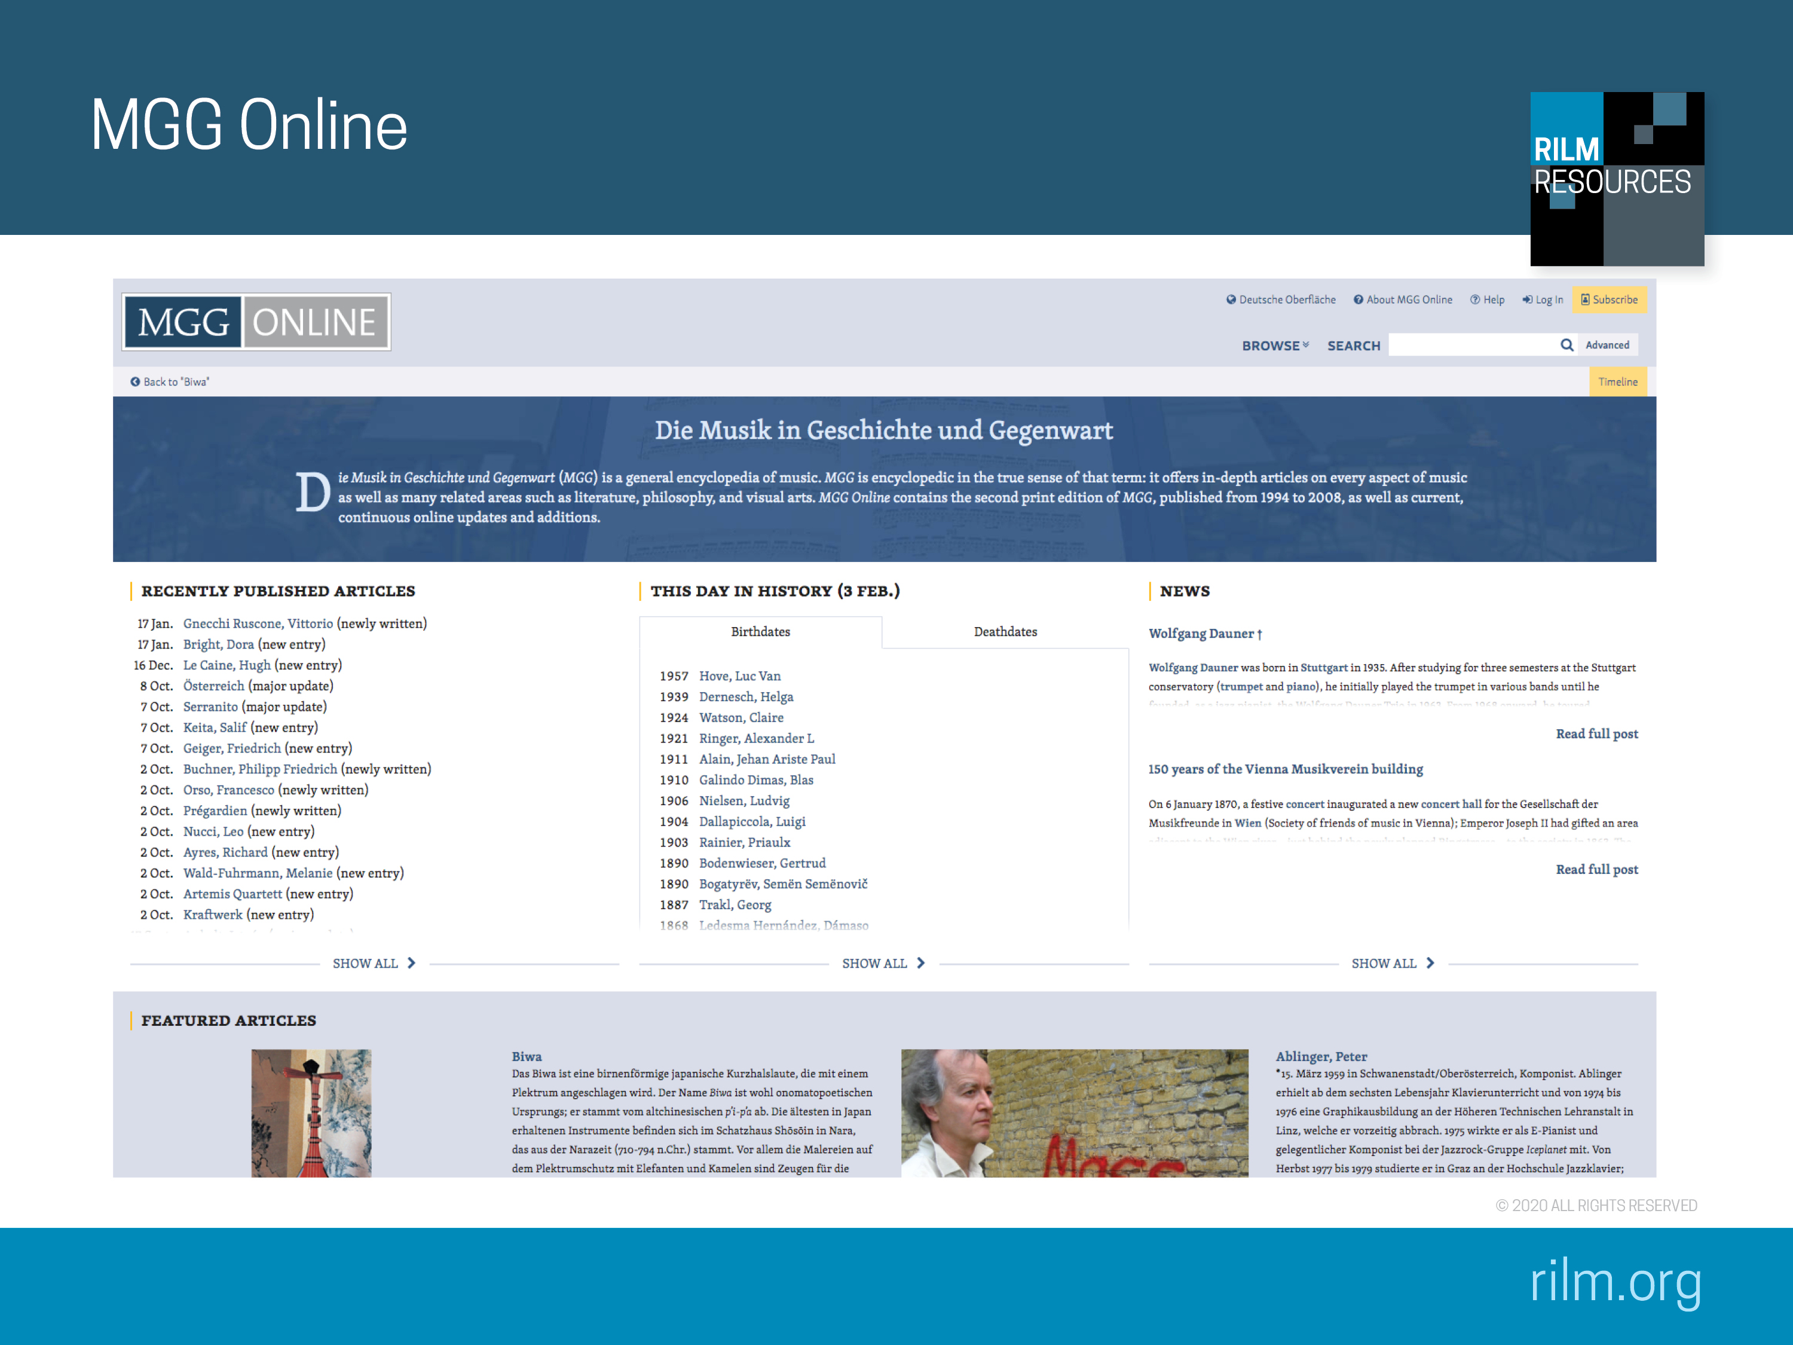
Notes:
Briefly look at MGG Online (https://www.mgg-online.com/) and then start searching. This screen also gives you a sense of the updating that is going on. Articles are updated and new articles are added on a continual basis.
Recommended Searches on mgg-online.com
1. Search Liszt, Franz > Works > Vocal music > Spiritual Music for Soloists and/or Choir and Orchestra: Collapse sidebar(s) and sort alphabetically or by indices (Raabe, Searle, E/M). The searches is indicative for the search capabilities within MGG Online and its speed, content, and bibliographic wealth.
2. Search world music: Look at the range of issues it addresses in left side article contents—representative of academic approaches to world music. Interested in world music markets? Click on V. There you will see mention of the 1987 meeting in London, significant labels, and important conferences (WOMEX)... covers the topic well. Click on Keil/Feld link to go to Bibliography—pretty good list of resources. Also, see internet link, which takes you right to world music related websites.
3. Search reggae, see > West Indies (including Literature), perhaps look at > “African American music” perspective (broader view on music created by people of African descent or exhibiting structural/conceptual features of African cultures in all of the New World rather than just the U.S.
4. Miles Davis: an unexpected reference to reggae; demonstrate Discography, Transcriptions, and Filmography. See also the Link to RILM Abstracts and GND link.
5. Search Glenn Gould: go to Documents, see list of online resources linked to specialty collections, see > Works > Discography, including link to online discography at the bottom of the list.
6. Search: Pierre Boulez and look at the different Article Versions, which can show how thinking on a certain topic has evolved, also good listing of Boulez’s writings and interviews > E I–III
7. Search: Drehorgel:
Drehorgel > Die musikalische und soziale Bedeutung der Drehorgel.
Scan the Literatur, is there any more specific information on the instrument's social history in Germany? Yes, search RILM Abstracts link > barrel organ (+ [Germany]). A comparable Google.de search [Drehorgel Sozialgeschichte] does not lead to any scholarly literature, incl. within Bücher.
8. Interested in music and public spaces and how commerce and (background) music interact? Search Psychologie: Musikpsychologie > Angewandte Musikpsychologie > Funktionelle Musik > Musik in Kaufhäusern
A lot of information and references here, or browse Related Content > Musiksoziologie > Problemfelder > Interaktion, Kommunikation > Kommunikationsstrukturen
9. If you want to play a piece by Bottesini, but not the famous concerto, what other works for double bass did he write? Search Bottesini: Bottesini, Giovanni > Werke > Instrumentalmusik > Werke für Kb. und Orch. Are these available with piano accompaniment, and is there any bibliographic information? (Internet searches are often unhelpful in relation to printed music.)
< Ausgaben > Für Kontrabaß und Klavier
10. For research on Nazism to gain a better understanding of the role that music played in relation to politics. Search Nationalsozialismus: Nationalsozialismus > Grundlinien nationalsozialistischer Musikpolitik > Die Politik der Ästhetisierung
A lot of information and references here, where can I find more?
Literatur > Spezielle Untersuchungen zur Musik im Nationalsozialismus
11. Interested in electronic music in Italy in the 20th century? Search elektronische Musik Italien: Italien > Kunstmusik > Das 20. Jahrhundert > Ab 1945 (searching [elektronisch] in this article) or: Elektroakustische Musik > Elektroakustische Musik ab 1950 > Live-Elektronik (searching [Italien] in this article)
Search RILM Abstracts for Musica Elettronica Viva and Nuova Consonanza, demonstrate examples.
If you need customized searches for your classroom, please contact tfruhauf@rilm.org.

