Slide 1
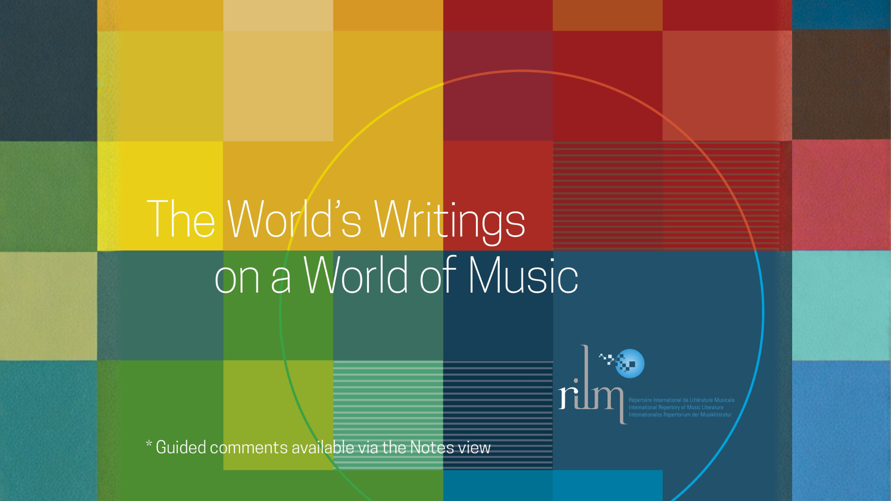
Notes:
Répertoire International de Littérature Musicale (RILM) collects, curates, and shares writings on music and music-related subjects from around the world, using the most advanced digital technologies available. A UNESCO-accredited organization, RILM is committed to preserving and making accessible music scholarship from all countries and in all languages, spanning cultural and disciplinary boundaries within the arts, humanities, sciences, and social sciences.

Slide 2
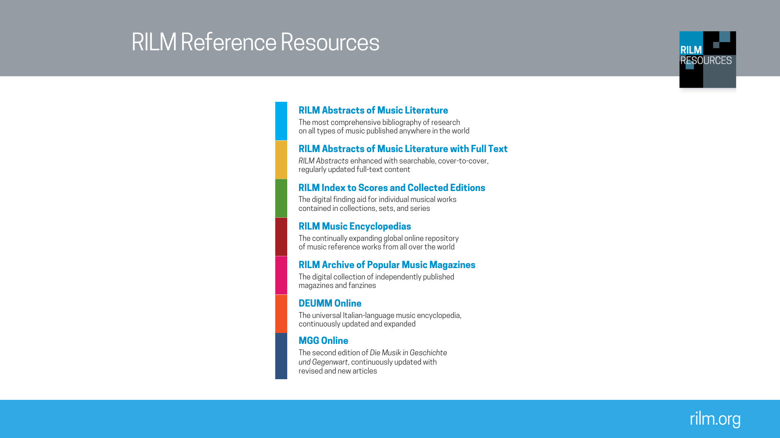
Notes:
RILM provides the following fully searchable collection of research resources:
RILM Abstracts of Music Literature: The most comprehensive bibliography of research on all types of music published anywhere in the world
RILM Abstracts of Music Literature with Full Text: RILM Abstracts enhanced with searchable, cover-to-cover, regularly updated full-text content
RILM Index to Scores and Collected Editions: The digital finding aid for individual musical works contained in printed collections, sets, and series
RILM Music Encyclopedias: The continually expanding online repository of music reference works from all over the world
RILM Archive of Popular Music Magazines: The digital collection of independently published magazines and fanzines
DEUMM Online: The universal Italian-language music encyclopedia, continuously updated and expanded
MGG Online: The second edition of Die Musik in Geschichte und Gegenwart, continuously updated with new and revised articles

Slide 3
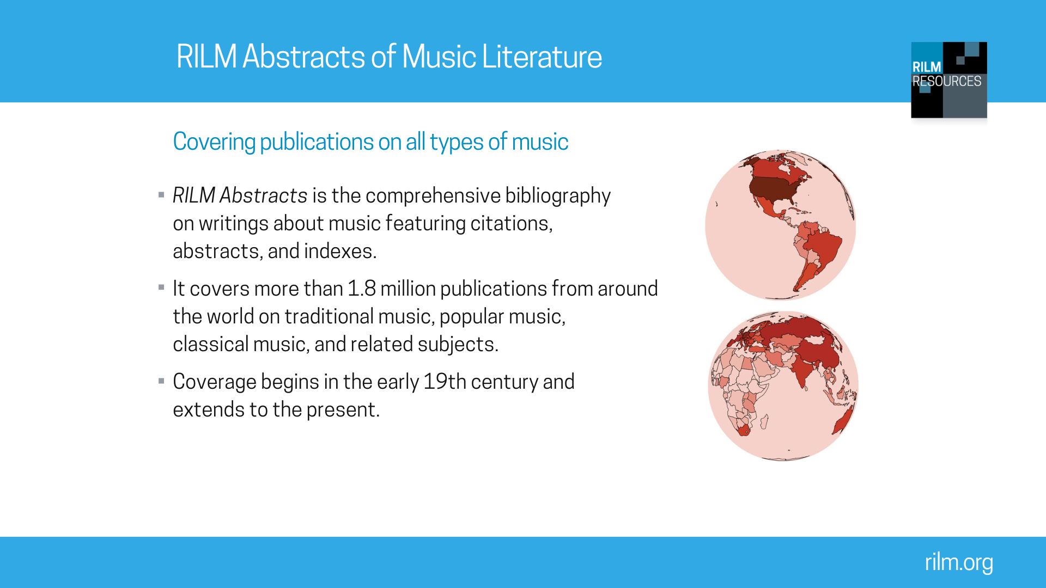
Notes:
RILM Abstracts of Music Literature abstracts and indexes significant writings about music from all over the world. RILM Abstracts currently contains over 1.6 million records, in over 140 languages, from about 180 countries.

Slide 4
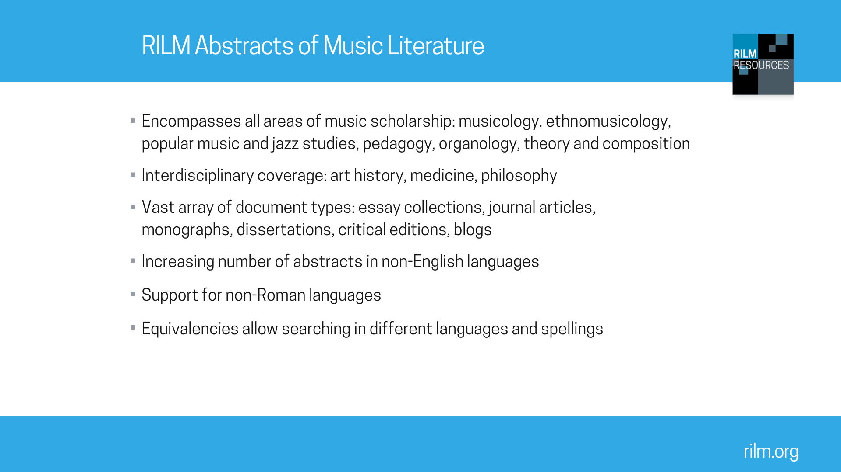
Notes:
RILM Abstracts of Music Literature covers all areas of music scholarship, while also aiming for strong interdisciplinary coverage, i.e. research in disciplines ranging from art history to therapy to philosophy.
RILM Abstracts’ records cover a vast range of document types, from journals and monographs to blogs and fan zines.

Slide 5
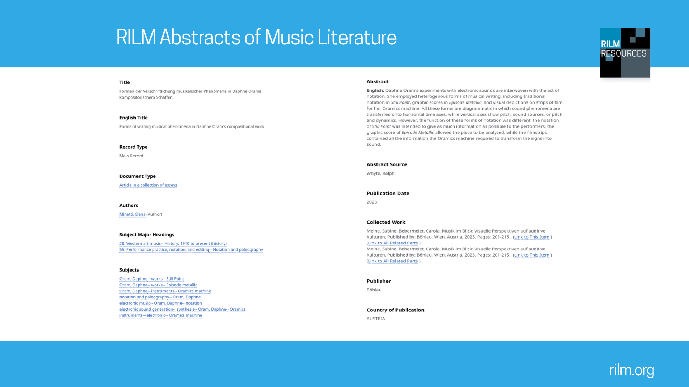
Notes:
Records in RILM Abstracts contain various information. This includes basic bibliographic data (author, title, document type [such as article in a periodical, monograph, or dissertation], and publication information). Titles in languages other than English are translated into English. Titles and names in non-roman alphabets are romanized.
They also include a list of Subjects. These are organized hierarchically in threads connected by “--”. Each thread starts more general (with a name or general subject matter) and becomes more specific. These threads are hyperlinked; you can click on any term in these threads to find articles labeled the same way.
Wherever possible, an abstract is included. These abstracts may be provided by the author, publisher, journal, or by a RILM editor. Abstracts are important not only as summaries but because they make items more searchable. When abstracts are in languages other than English, an English-language translation is provided.

Slide 6
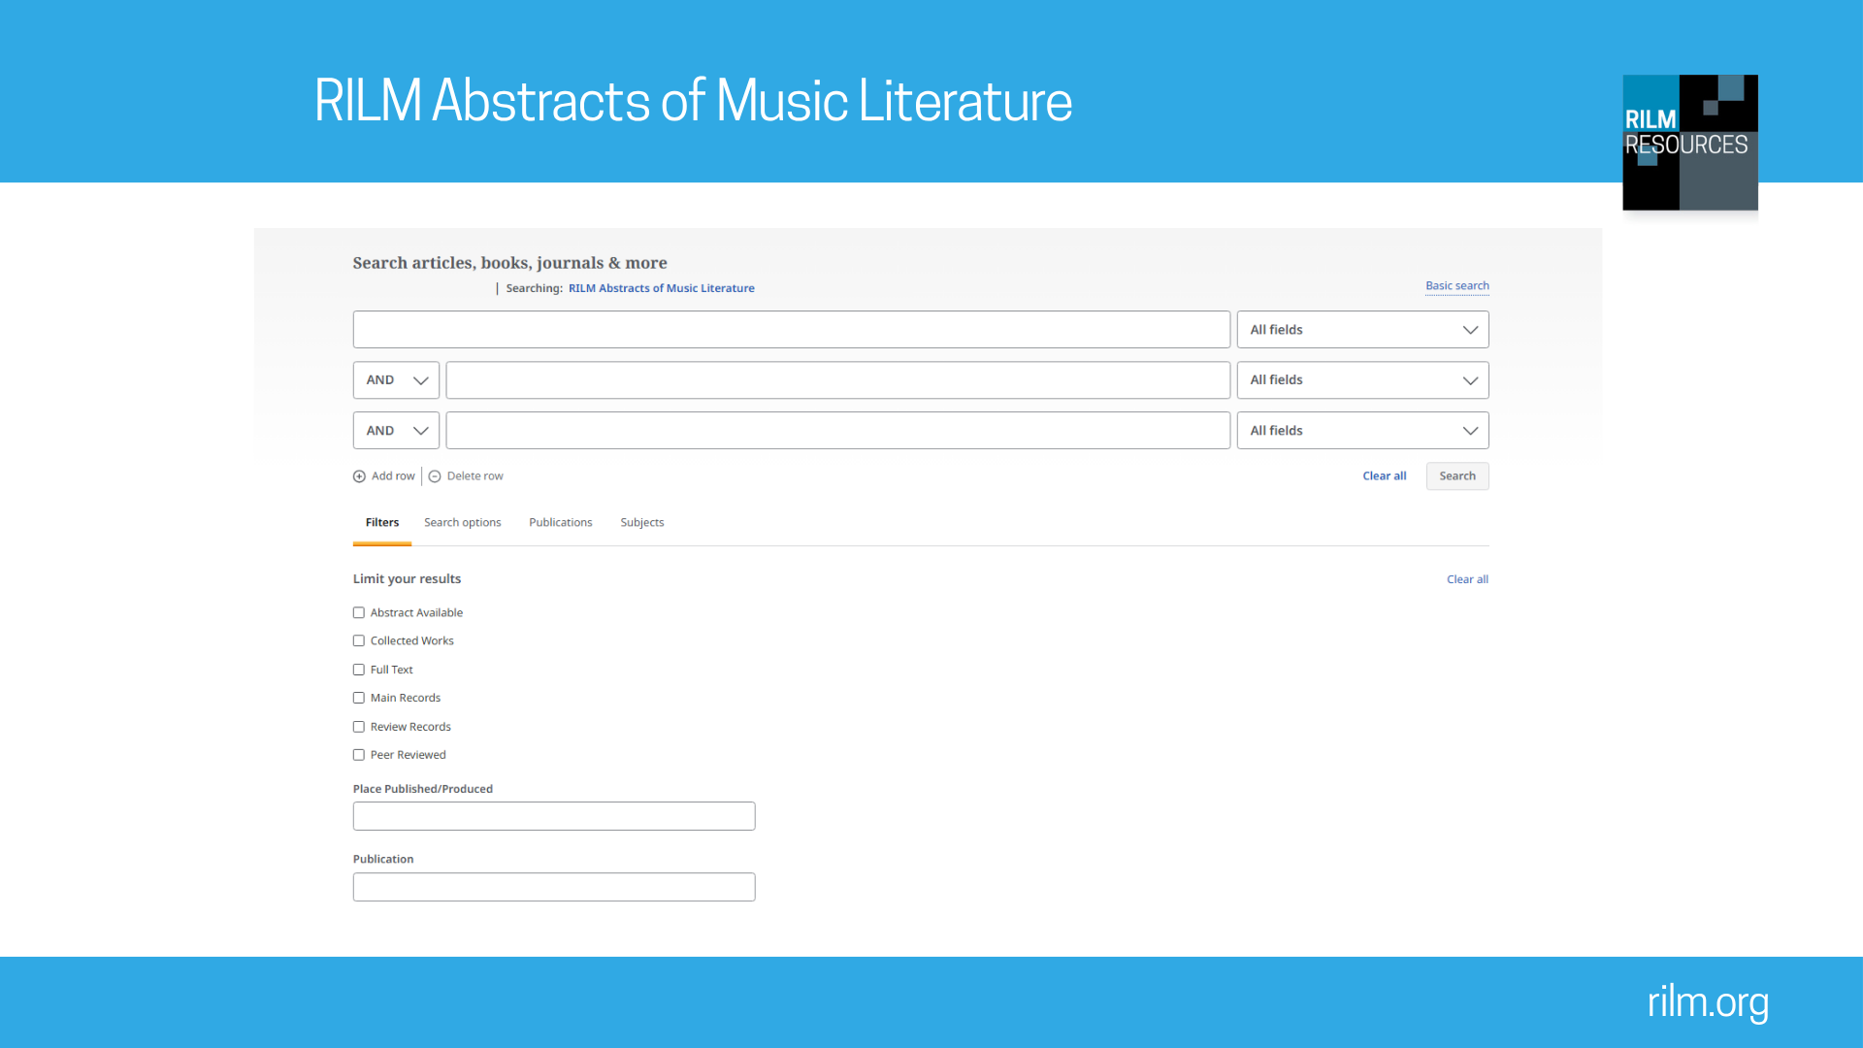
Notes:
RILM Abstracts is available on EBSCOhost. You can search in specific fields (e.g., by author name, by title, or by language). You can limit results (e.g., only showing results that feature an abstract) or specify a date range. You can also filter results after making an initial search.
Recommended searches on EBSCOhost
1) Search film music.
What does this search show? Because of the large number of results, it is possible to demonstrate various filters (choose All Filters). You can, for example, demonstrate a search filtered by language, document type, or limit your search to records with abstracts. Ways to limit this search include by adding the name of a film composer (search film music and Korngold) or by adding a place (search film music and Nigeria).
2) Search therapy and tango. As this is a more narrow search, you will receive a relatively small number of results. If you read the abstracts of some of these, you will discover research on the effects of tango dancing on Parkinson’s disease and mood disorders, among others.
What does this search show? RILM Abstracts is highly useful also for cross-disciplinary searches. This search demonstrates, for example, that literature on both medicine and dance is included in RILM Abstracts. There are thousands of records on various medical topics; there are over 100 alone on Beethoven’s medical conditions. If you want to concentrate on therapy, a search for “music therapy” on RILM Abstracts will yield over 20,000 results, while a search for “dance therapy” also provides several hundred.
3) Search 18th century Viennese string quartet then search Vienna and string quartet and (18th c or Classic). The first option yields few results. Given the importance of 18th-century Vienna to the development of the string quartet and the fact that music of this period and geography has been well studied in music history, this might seem surprising. The second search strategy, however, yields far more results.
What do these searches show? It is important to be aware of different search strategies. Boolean operators (and, or, not) and parentheses remain useful for database searches. The search “Vienna and string quartet and (18th c or Classic)” yields both more results and more relevant results as the use of operators and parentheses makes it easier for the search engine to parse what is being searched for.
If you need customized searches for your classroom, please contact info@rilm.org.

Slide 7
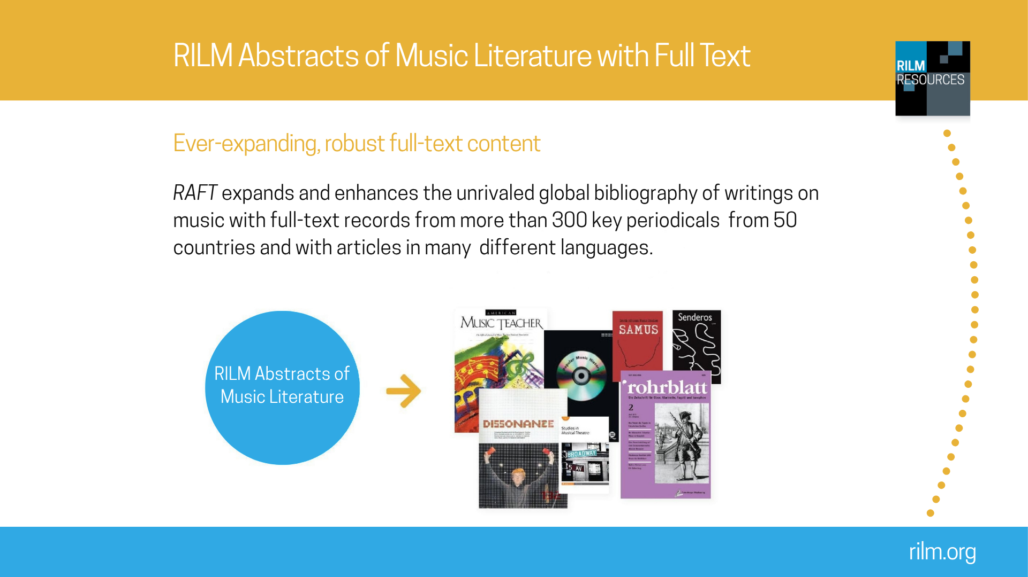
Notes:
RILM Abstracts of Music Literature with Full Text (RAFT) integrates the comprehensive RILM Abstracts database with complete, cover-to-cover runs of over 300 journals in PDF format. Beyond the primary articles, RAFT comprises hundreds of thousands of auxiliary documents, including front and back matter, news items, advertisements, and other supplemental materials that offer valuable insights into global musical cultures across various eras.
Searching within the full text allows for the discovery of specific terms, names, or niche details appearing only within the PDFs—information that would otherwise remain inaccessible through a search of the RILM Abstracts alone.
If you want to see a list of all journals included in full text, go to rilm.org/fulltext.

Slide 8
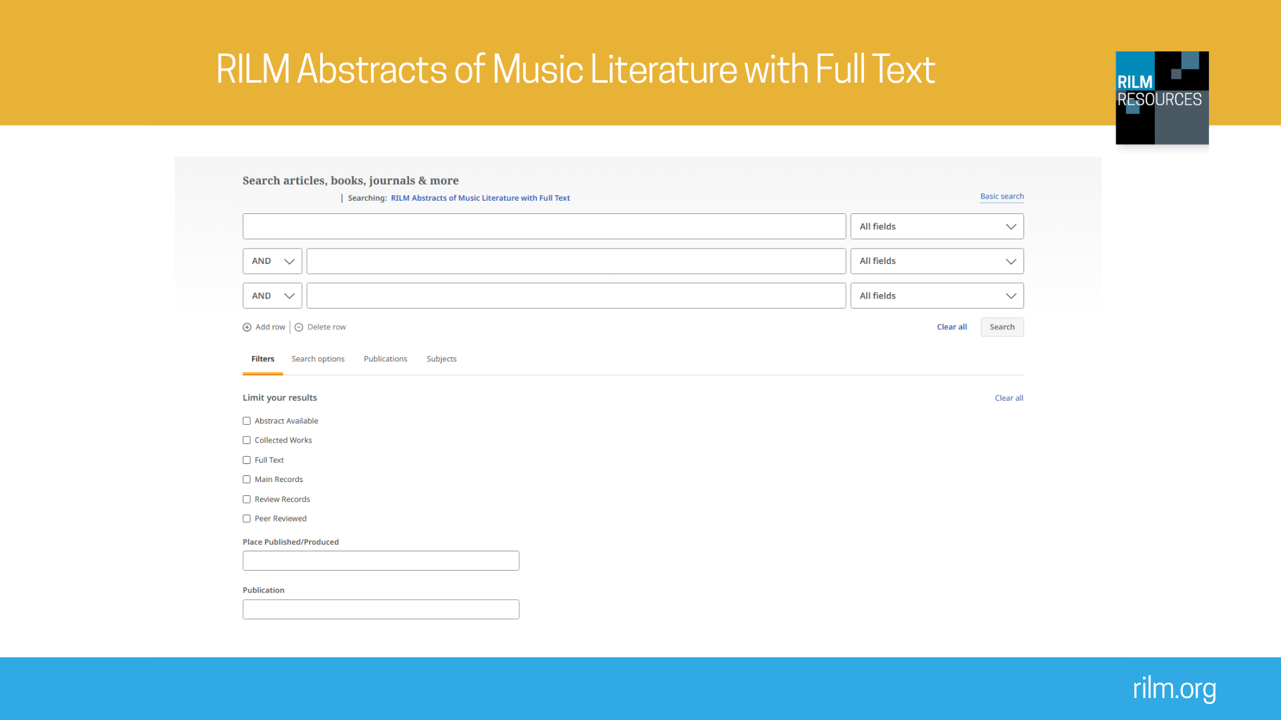
Notes:
Recommended searches on EBSCOhost
1) Search India and dance. Under Advanced Search Options then Filters, click Full Text to include only items available in full text. Look through some of the results. The text is available at the bottom of each result, but to access the original typography and images, view the full text in PDF. Note that some of these full texts may be provided by EBSCO databases other than RAFT. This initial search should produce a very large number of results. To narrow down further, search India and dance and pedagogy.
What does this search show? Many journal articles are now available in full text, allowing researchers to access them immediately. Both searches yield a large number of results, demonstrating the breadth of coverage on dance, ethnomusicology, and pedagogy in RAFT. The PDFs also allow researchers to consult the original typography, illustrations, and other visual material.
2) Search hip hop. Press the Full Text button in order to limit your results to items available in full text in RAFT.
What does this search show? It demonstrates our coverage in the area of popular music. The large number of results allows you to show how to use various filters. You can also limit the search by adding further terms. One way to do this is to add in the name of a country (for example, hip hop and Kenya or hip hop and Senegal). Alternatively, search hip hop and copyright. Searching by geography demonstrates the global nature of the art form and global nature of the writing on it, while searching for hip hop and copyright opens a window on the ever-evolving relationship between popular music, digital technology, creative practice, the music industry, and law.
3) Search crwth. This is a Welsh bowed lyre. Again make sure that Full Text is selected. Here you should only receive a few results given the relatively specific subject matter. Then search crwth again but first press Advanced Search then Search Options and click the box that reads Also Search Within the Full Text of Articles. This option will give you more results.
What does this search show? Even when terms are not indexed, they may still appear in full-text searching. This is an opportunity to explain and explore the difference between the curated, filtered searching of metadata, and the more exploratory searching that can result from full-text searches.
If you need customized searches for your classroom, please contact info@rilm.org.

Slide 9
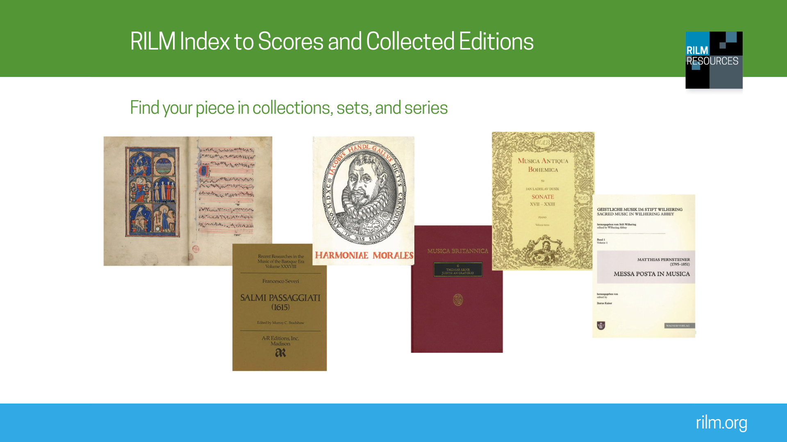
Notes:
The RILM Index to Scores and Collected Editions (RISE), formerly known as the Index to Printed Music, remains the authoritative digital finding aid for locating individual pieces of music contained in collections, sets, and series. Finding those individual pieces within complete editions, monuments, anthologies, or other collections, can be a real challenge, because they may not be indexed separately from their sets or volumes in library catalogues. The purpose of RISE is to be able to search for and find these individual pieces within authoritative editions. You can search by several different parameters—for example, by work title, genre, performing force, instrumentation, and more. And it's very easy to find multiple editions of one work for comparison.

Slide 10
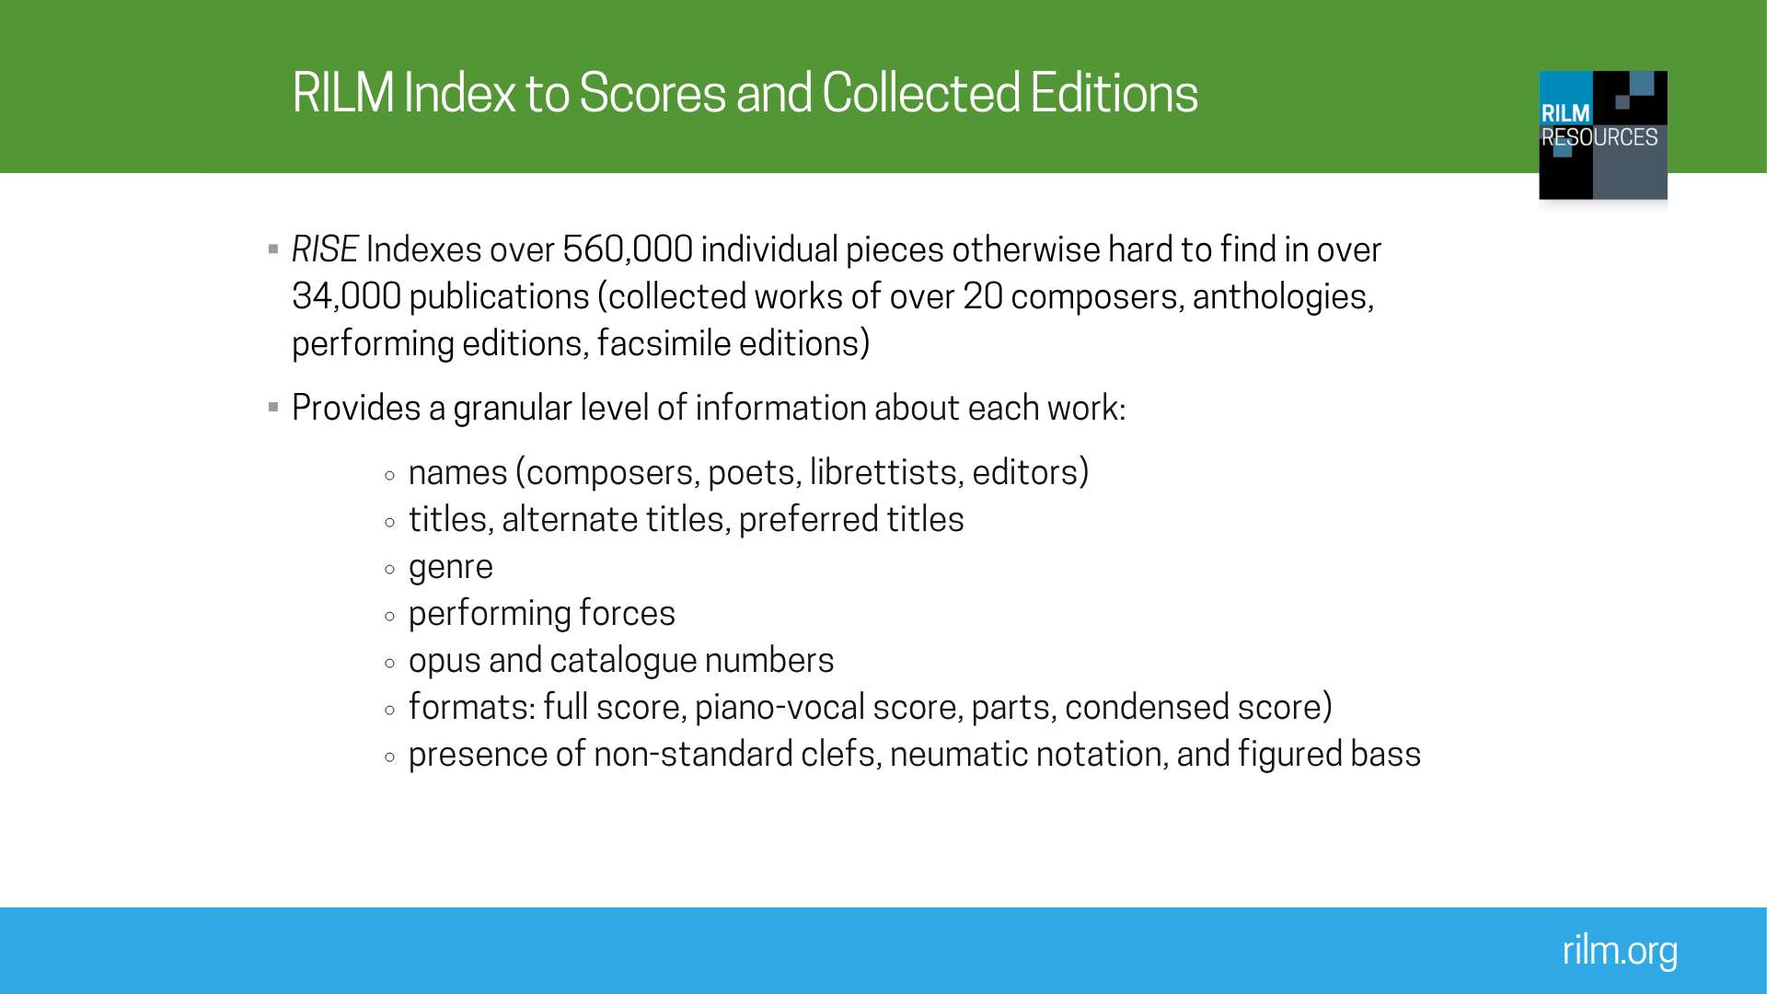
Notes:
RISE contains records for 560,000+ individual pieces, and over 34,000 volumes of music. RISE covers a wide range of editions, including the collected works of composers ranging from Josquin to Janáček, a wide array of historical and geographical sets and series, such as the Denkmäler deutscher Tonkunst and Recent researches in American music, anthologies including the Norton anthology of Western music, and facsimile editions.
Each individual record contains far more information about each work than you are likely to find in a library catalogue.

Slide 11
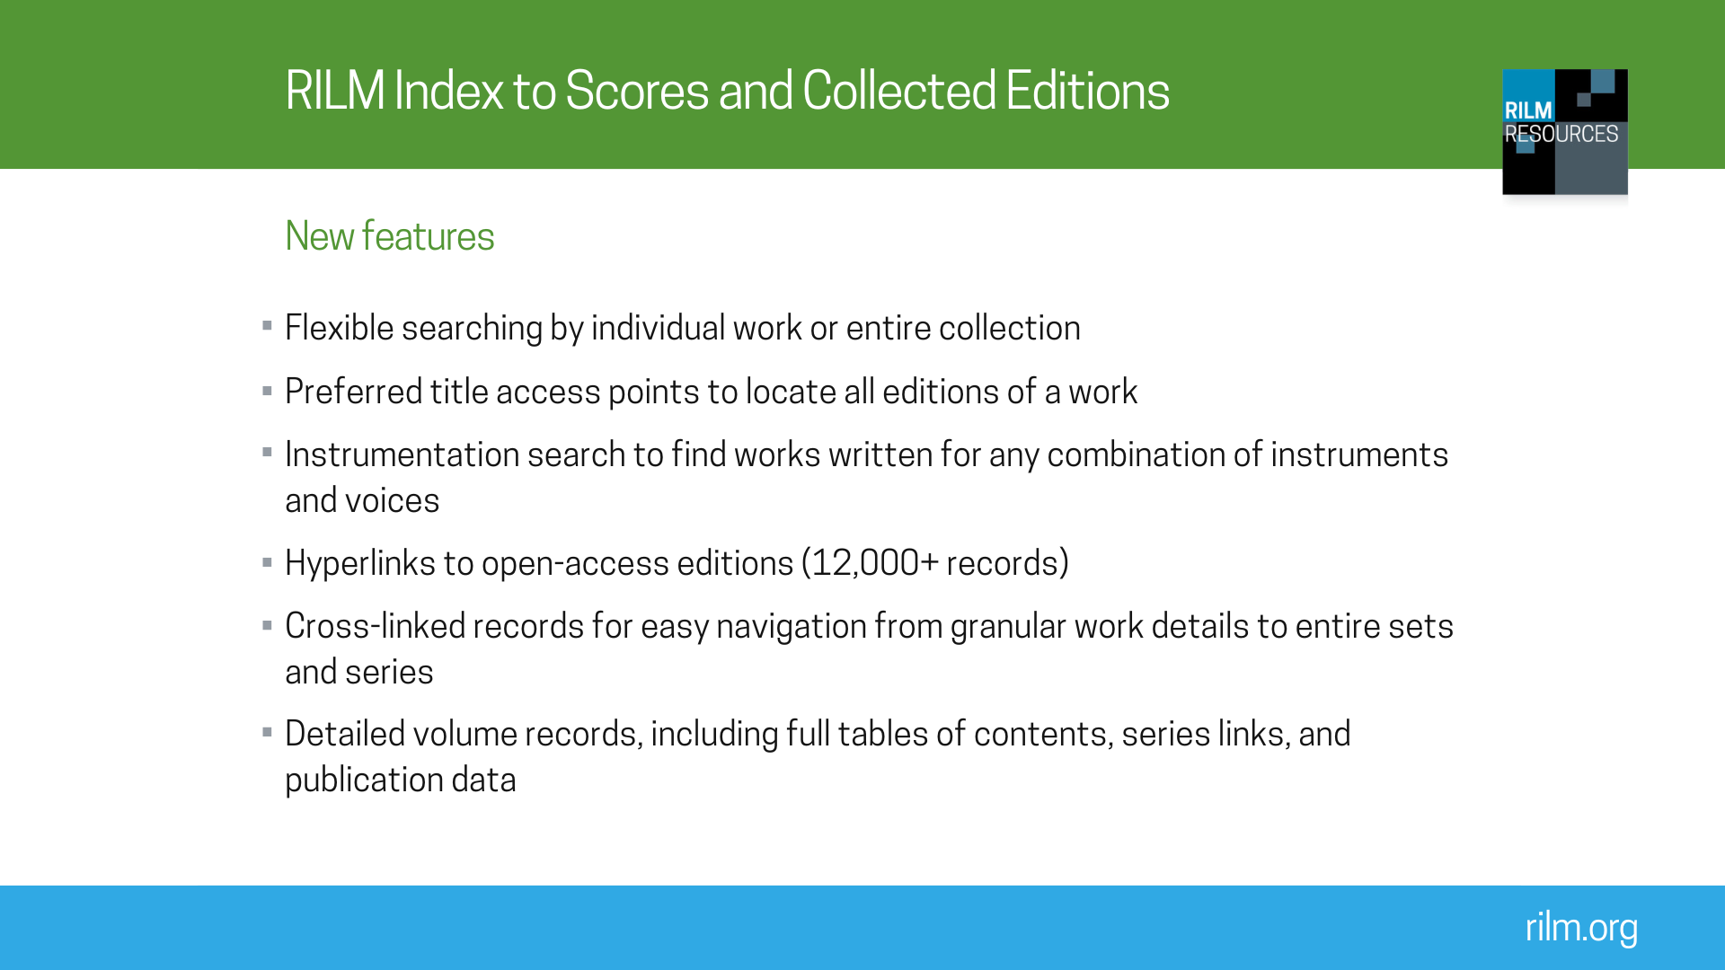
Notes:
RISE includes a number of improvements and new features:
Flexible searching by individual work or entire collection
One new feature is the preferred title. This hyperlinked field allows users to view all editions of a work available in RISE. For example, a record of Händel’s Messiah will include a link that will take users to the ~126 other records of the same work. These include the original complete works edition from the 19th century, the contemporary Hallische Händel Ausgabe published by Bärenreiter, and even various anthologies of music that include an excerpt of the work.
The instrumentation search finds works written for any combination of instruments and voices.
Hyperlinks to open-access editions (over 12,000 records): This includes the Neue Mozart Ausgabe, several 19th-century editions, and born-digital editions like the English heritage music series.
Cross-linked records for easy navigation from granular work details to entire sets and series
Detailed volume records, including full tables of contents, series links, and publication data

Slide 12
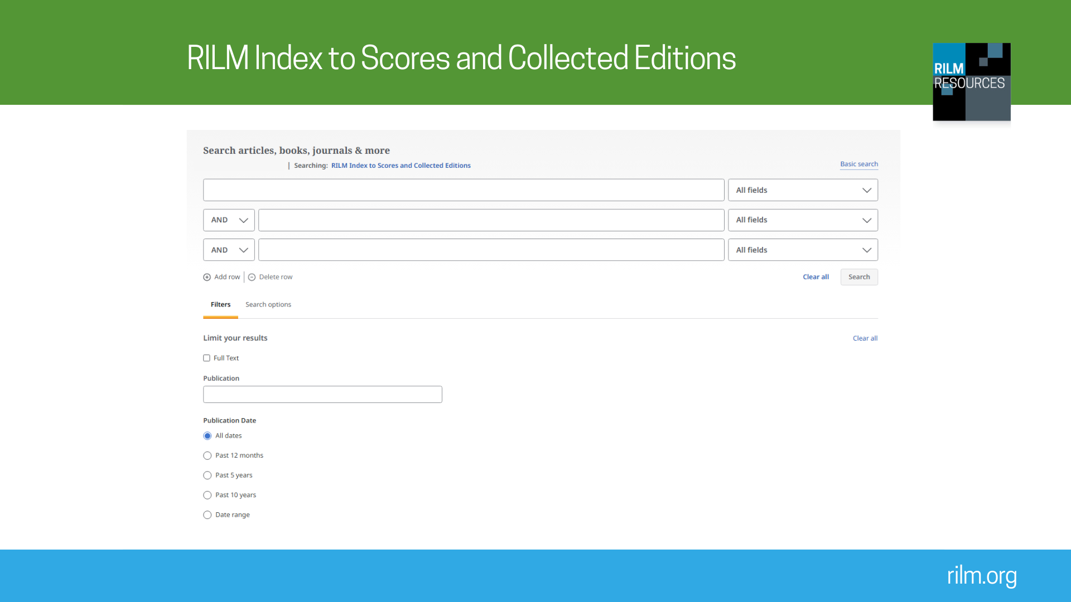
Notes:
RISE, like RILM Abstracts, is searchable via EBSCOhost. Advanced search capabilities allow you to search by composer and genre.
Recommended searches on EBSCOhost
1. Select Advanced Search. Type Florence Price in the search bar and from Fields, select Composer. This search should bring back over 40 results. Return to the Advanced Search page. Narrow the search to songs by typing song in a second search bar and selecting Genre from the Fields list. This will shrink search results. Scrolling through this list, you may notice that there are two different records for “Song to the dark virgin”. This is because RISE has indexed two different anthologies that both contain it. Click on these records and you will notice the publisher is different (the other information is the same).
What do these searches show? These searches demonstrate different ways to search RISE. The records for “Song to the dark virgin” demonstrate the depth of bibliographic information available on RISE: page numbers, genre, the language, format of the score, instrumentation, and even the first line of text. Click into the other record for this song and you will notice the publisher is different (the other information is the same).
2. Do a basic search for Adon Olam. Then on Advanced Search page, enter Adon Olam in the first search bar with no field specified and type Salamone Rossi into the second bar, specifying the Composer field. You should get one result.
What do these searches show? The search for Adon Olam highlights the large number of anthologies dedicated to traditional music of many different cultures that RISE has indexed. The results for this search include settings of Adon Olam from a synagogue in Curacao; settings that date from an 18th-century Italian Jewish community; and dozens of settings found in Hebräisch­-orientalischer Melodienschatz.
The record for Rossi’s setting demonstrates many of the things that RISE does best. You can see at the top of the record that this setting is found in Rossi’s complete works, and the bibliographic information indicates exactly where to find it within that collection. This record also contains several additional useful bits of information you would not normally find in a library catalogue record. The genre, language, and incipit are all provided, in addition to instrumentation. Finally, the source note field provides information about the manuscript source for the edition, when available. In this case, it provides a RISM number so you could easily go look up the manuscript source in the RISM online catalogue. Go to opac.rism.info, search A/1 or B/1 number = R 2761; then you can click the Read Online link in the RISM record to get to the full text.
If you need customized searches for your classroom, please contact info@rilm.org.

Slide 13
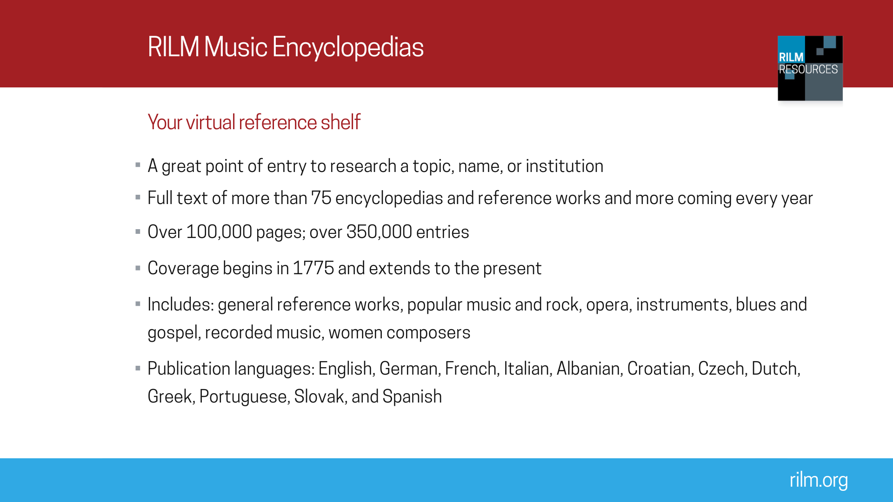
Notes:
RILM Music Encyclopedias (RME) is an annually expanding full-text compilation of reference works that can be searched on one click. When it was launched, the collection included 41 encyclopedias and dictionaries of music. Every year, we add new titles. Our encyclopedias cover a vast range of topics, from opera to marching bands to blues and gospel, and our collection includes publications in many different languages and published from 1775 to the present. For a full title list go to: http://www.rilm.org/encyclopedias/

Slide 14
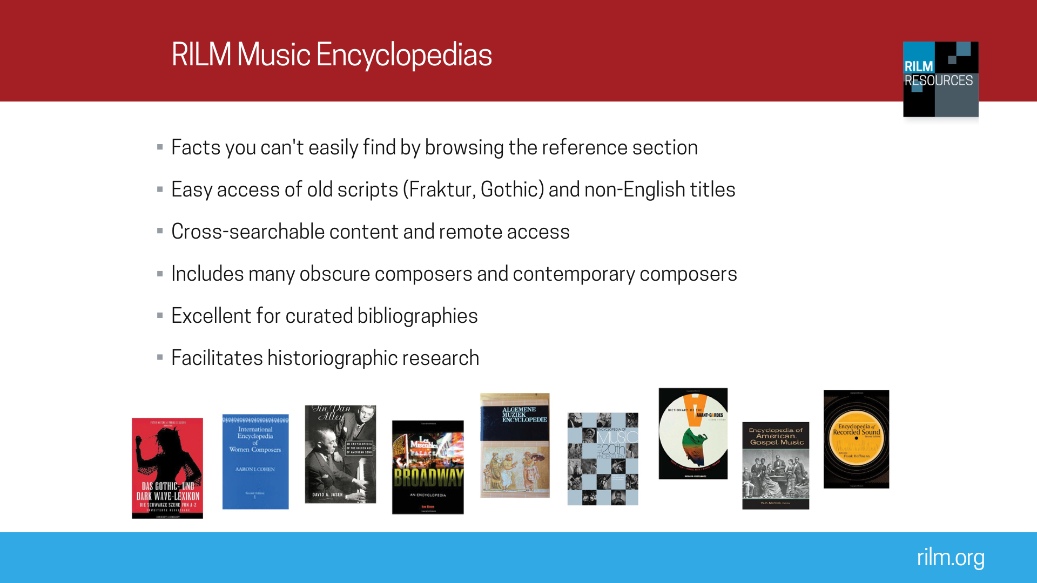
Notes:
There are various reasons you might turn to RME over the traditional reference shelf. You can search and browse now over 75 reference works, translate articles into your working language, and more.

Slide 15
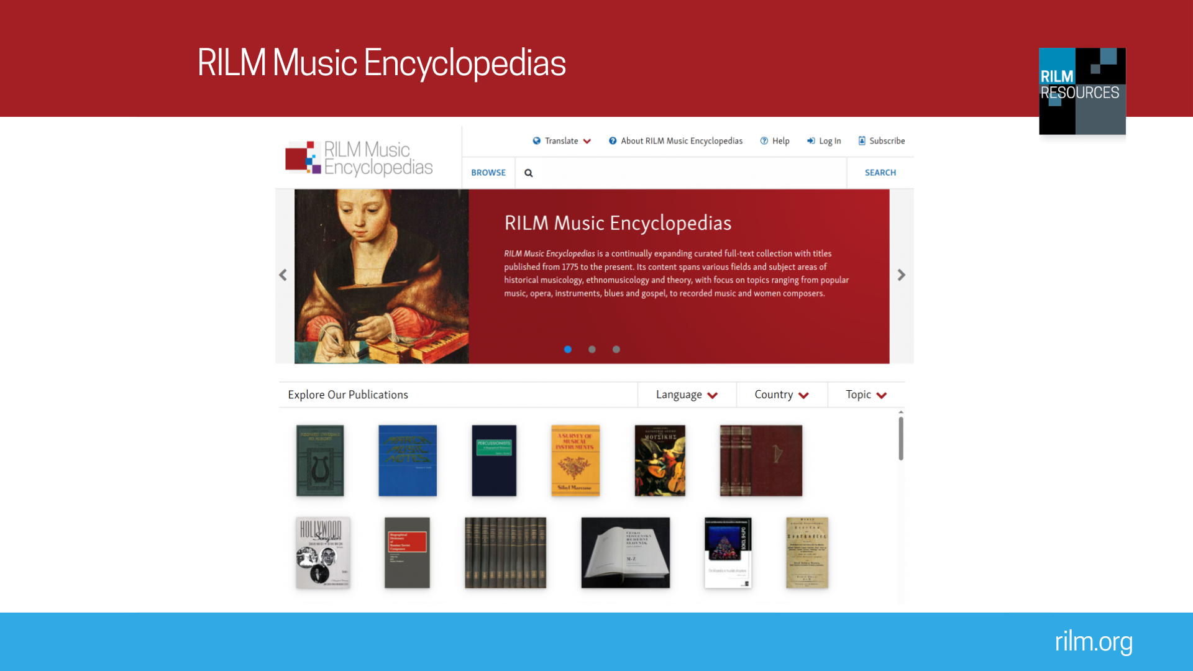
Notes:
You can access this resource via EBSCOhost and RILM’s own platform Egret.
Recommended searches on rme.rilm.org/ or EBSCOhost
1. Search harpsichord. Peruse the results: Entries “Harpsichord”, “Clavecin”, “Cembalo”, “Klavier”, “Steertstück”, “Gravicembŏlo”—all equivalent terms—should appear.
What does this search show? RME can be searched by musicologists in different languages as it includes equivalencies so that you can search Čajkovskij, Tchaikovsky, Tschaikowsky, etc. and still retrieve the maximum of search results possible.
2. Search Mozart. Then go to the Advanced Search screen and select Geographic Entry. On the result list you will find the entry “The Middle East”, by Jane Prendergast, Encyclopedia of Music in the 20th Century. Here you find out that "Fairuz had a wide repertoire including Mozart, flamenco, Balkan folklore and Latin American rumbas".
What does this search show? This knowledge is crucial for an ethnomusicologist working on Fairuz (“the most widely admired and deeply respected living singers in the Arab world,” per Wikipedia) and a historical musicologist working on Mozart reception in the Middle East, yet they would never find it by going to the shelf and looking through the hard copy, as it is not indexed. RME clearly has a functionality that a bookshelf cannot offer.
3. Search Helmut Lachenmann. The first few search results are name entries for the composer born in 1935 in Germany, including an article from Komponisten der Gegenwart.
What does this search show? RME contains an ongoing, continuously updated encyclopedia, the Komponisten der Gegenwart. His particular entry has been updated in 2016. This is especially valuable for living composers. This search also shows the merits of RME for historiographic research, as the music researcher can easily compare the 2016 Komponisten der Gegenwart entry with the 1974 entry in Muzička enciklopedija and the 1981 entry in Algemene muziek encyclopedie.
If you need customized searches for your classroom, please contact info@rilm.org

Slide 16
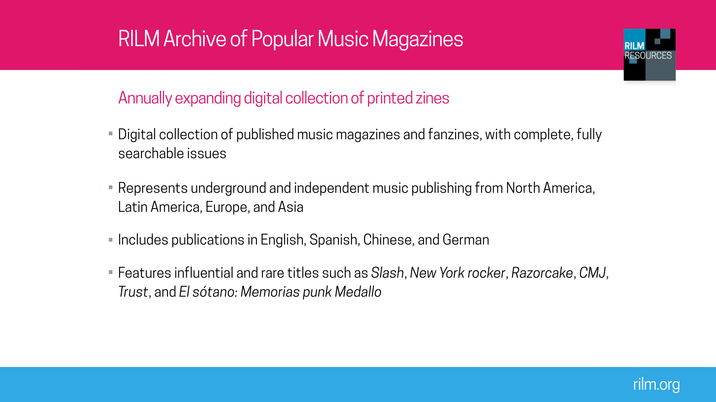
Notes:
The RILM Archive of Popular Music Magazines (RAPMM) is a digital collection of independently published popular music magazines and fanzines. RAPMM brings over 135 titles together in one place, with front-to-back issues scanned from their sources and made available in digital form.

Slide 17
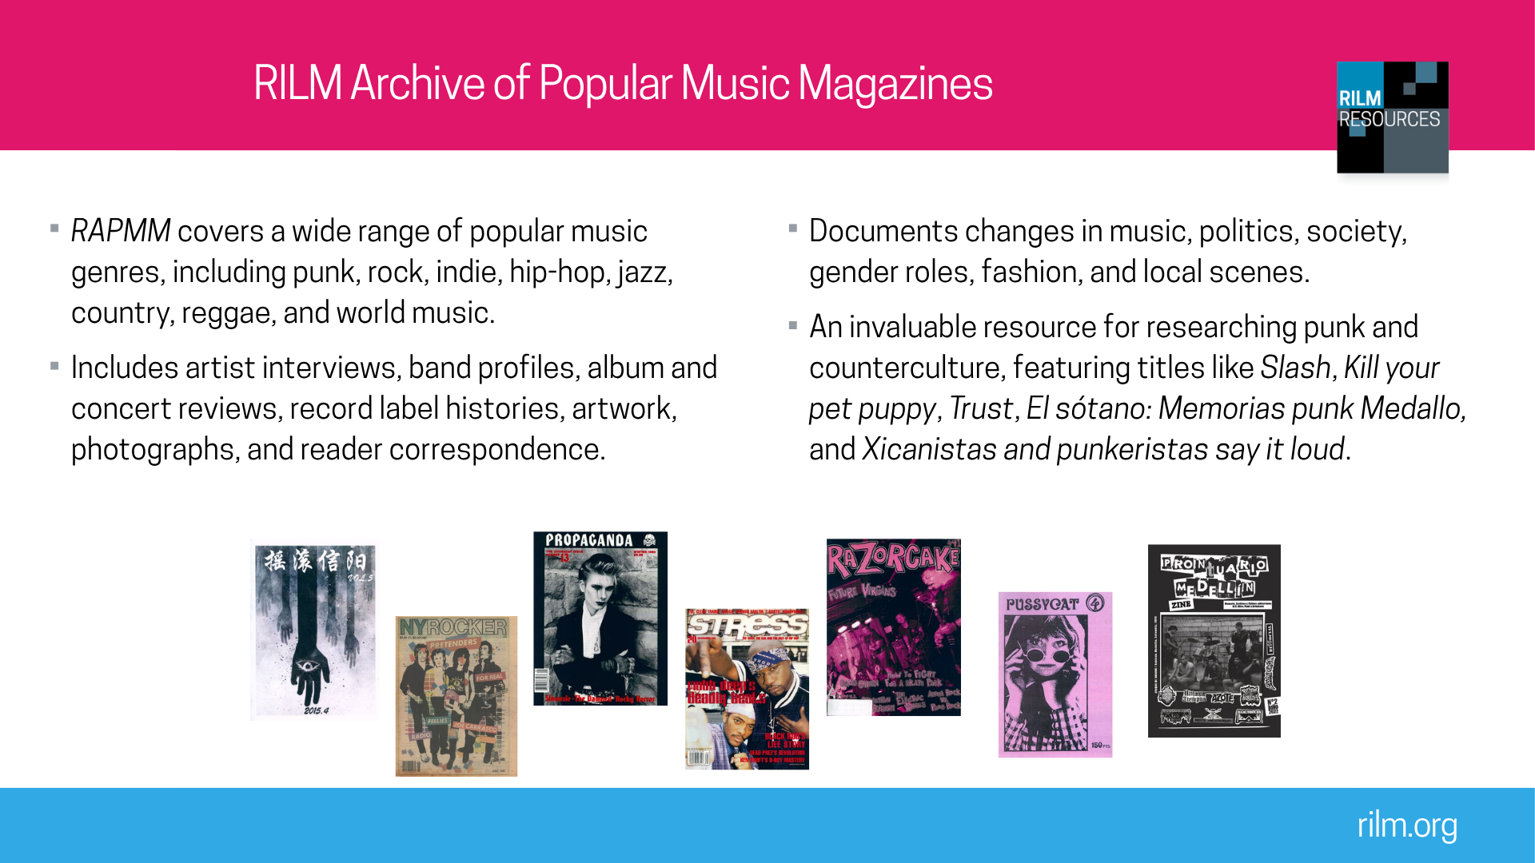
Notes:
The magazines and zines in RAPMM cover a wide array of popular music genres, highlighting the expansive punk world and its many subgenres, as well as other rock genres, hip-hop, country, reggae and more. The collection’s fully searchable contents document the history of musical movements and their relation to politics, society, culture, underground scenes, stylistic shifts, gender identities, fashion, and local scenes. RAPMM titles include interviews with recognized and obscure artists, band profiles, album and live show reviews, histories of record labels, reader correspondence, photos and other visual art, and advertisements.
Content warning: Please be aware that RAPMM includes some explicit content that may be offensive or harmful to some users. This content is unredacted to ensure the completeness of the collection and remains unaltered to retain historical accuracy. It documents the issues and social context of specific times as well as the attitudes and opinions of the people who created the material.

Slide 18
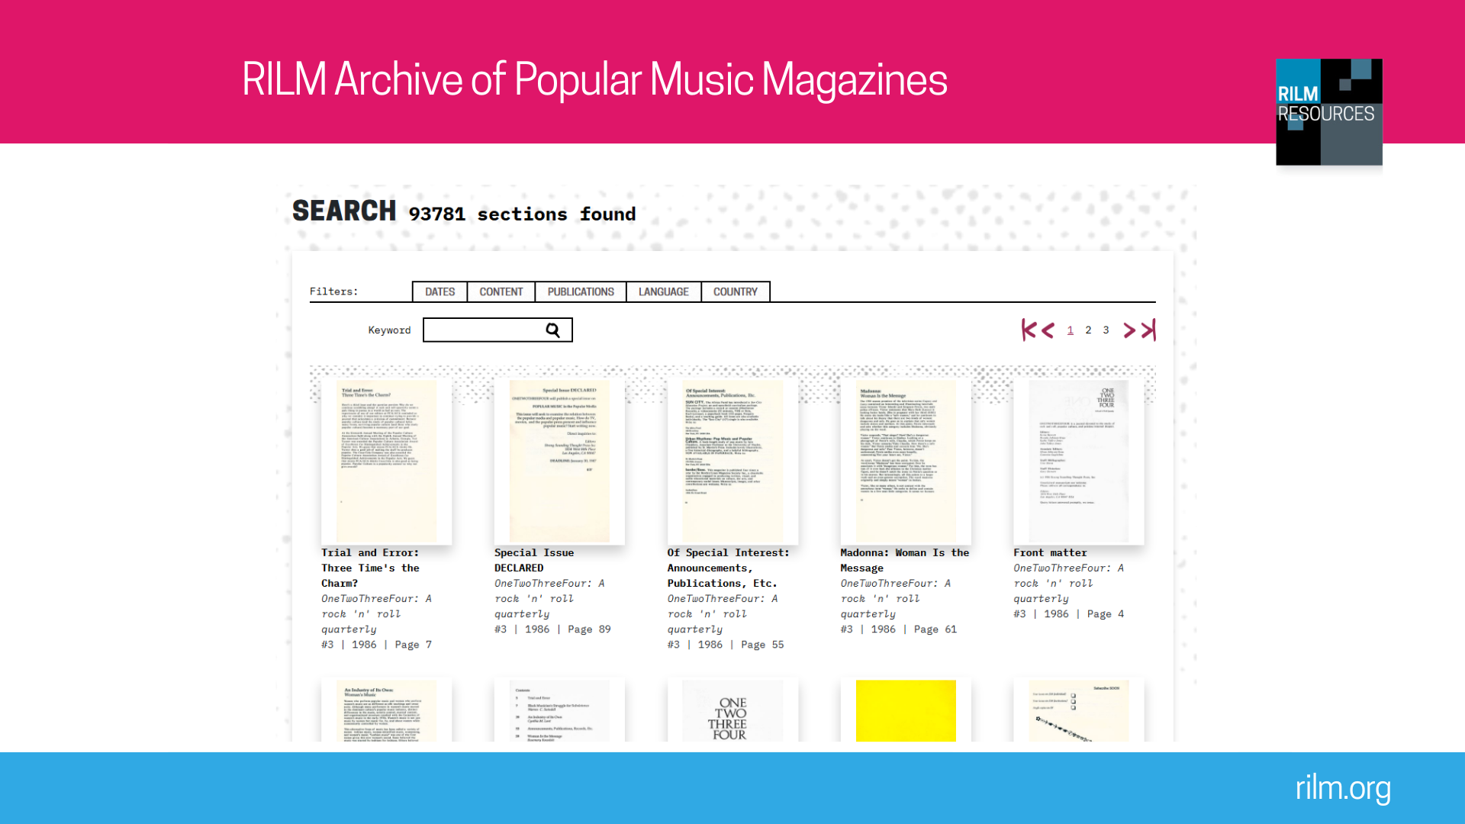
Notes:
RAPMM’s interface is available in six languages: English, Spanish, French, Italian, German, and Chinese. The content of each section in an issue can also be translated into any of these languages.
You can search the full text of RAPMM content via SEARCH ALL in the header. On the results screen, there are tabs that offer filters on date of publication, type of content (review, interview, advertisement, etc.), and name of publication. You can also search within a single publication or within a single issue.
The PUBLICATIONS page linked in the header provides a browsable list of all titles. From there you can click on any cover image to view a popup with some info about the publication and navigate to its dedicated page, which features a brief prose description of the title, full publication information, and a scrollable timeline of issues.
When viewing a single issue of a publication, you can expand a clickable table of contents at left and more information about the issue at right, as well as view and translate the text of each page in plain HTML and search within the issue. Three page view options are available: single page, book view, and gallery of all pages. A simplified fullscreen viewer can be entered by clicking on the expand icon at top right.
Recommended searches on rapmm.rilm.org
1. Search Cleveland. Among the results for this search are an interview with Pere Ubu’s David Thomas in a 1993 issue of Seconds, a 1994 Cleveland rock scene report in CMJ, a cartoon depicting “The Cleveland heckler” in Roctober, and advertisements for Herb Jackson Records, Trans Am, and a Cleveland biker safety event.
What does this search show? The content in RAPMM offers numerous on-the-ground accounts of localized music scenes through coverage of bands, labels, venues, community organizations, etc. Advertisements, too, document the ever-shifting cultural landscapes of places.
2. Search emo. Also click on DATES at the top of the page.
What does this search show? Searching in combination with the dates filter can help you track the emergence of a genre or movement. Looking at the dates of the term emo reveals that it began to be used in the 1980s and became more frequent through the 2000s. Search results evidence strong positive and negative reactions, associated artists and bands, and intersecting related genres (hardcore, indie rock, etc.).
3. Search roller derby. Results should include the introductory “Roller derby basics” in the German magazine Underdog, an interview on the topic of the Arizona roller derby in the long-running LA punk zine Razorcake, and a profile on roller derby star Queen Calvello in Girlyhead.
What does this search show? In RAPMM, you can learn about a host of cultural phenomena. This includes sports. Those interested in connections between skateboarding and punk and beyond will accurately be thinking that they will find numerous references to skating across RAPMM, but perhaps more surprising will be discussion of other sports, from baseball to roller derby.
4. Click on PUBLICATIONS. Locate the German fanzine Underdog. Scroll to issue 33 (2010). Press View Issue. Choose page 8. This is a profile of “German pioneers” Kraftwerk and Deutsch Amerikanische Freundschaft.
What does this search show? Browsing is another research method available through RAPMM. Using the publication search allows you to get a sense of an individual zine within the collection—in this case a politically committed German punk fanzine of the 21st century. Picking an individual article also shows RAPMM’s multilingual possibilities: While the publication is in German, the HTML version of the text of the article can be translated into English as well as Chinese, French, Italian, and Spanish.
If you need customized searches for your classroom, please contact info@rilm.org.

Slide 19
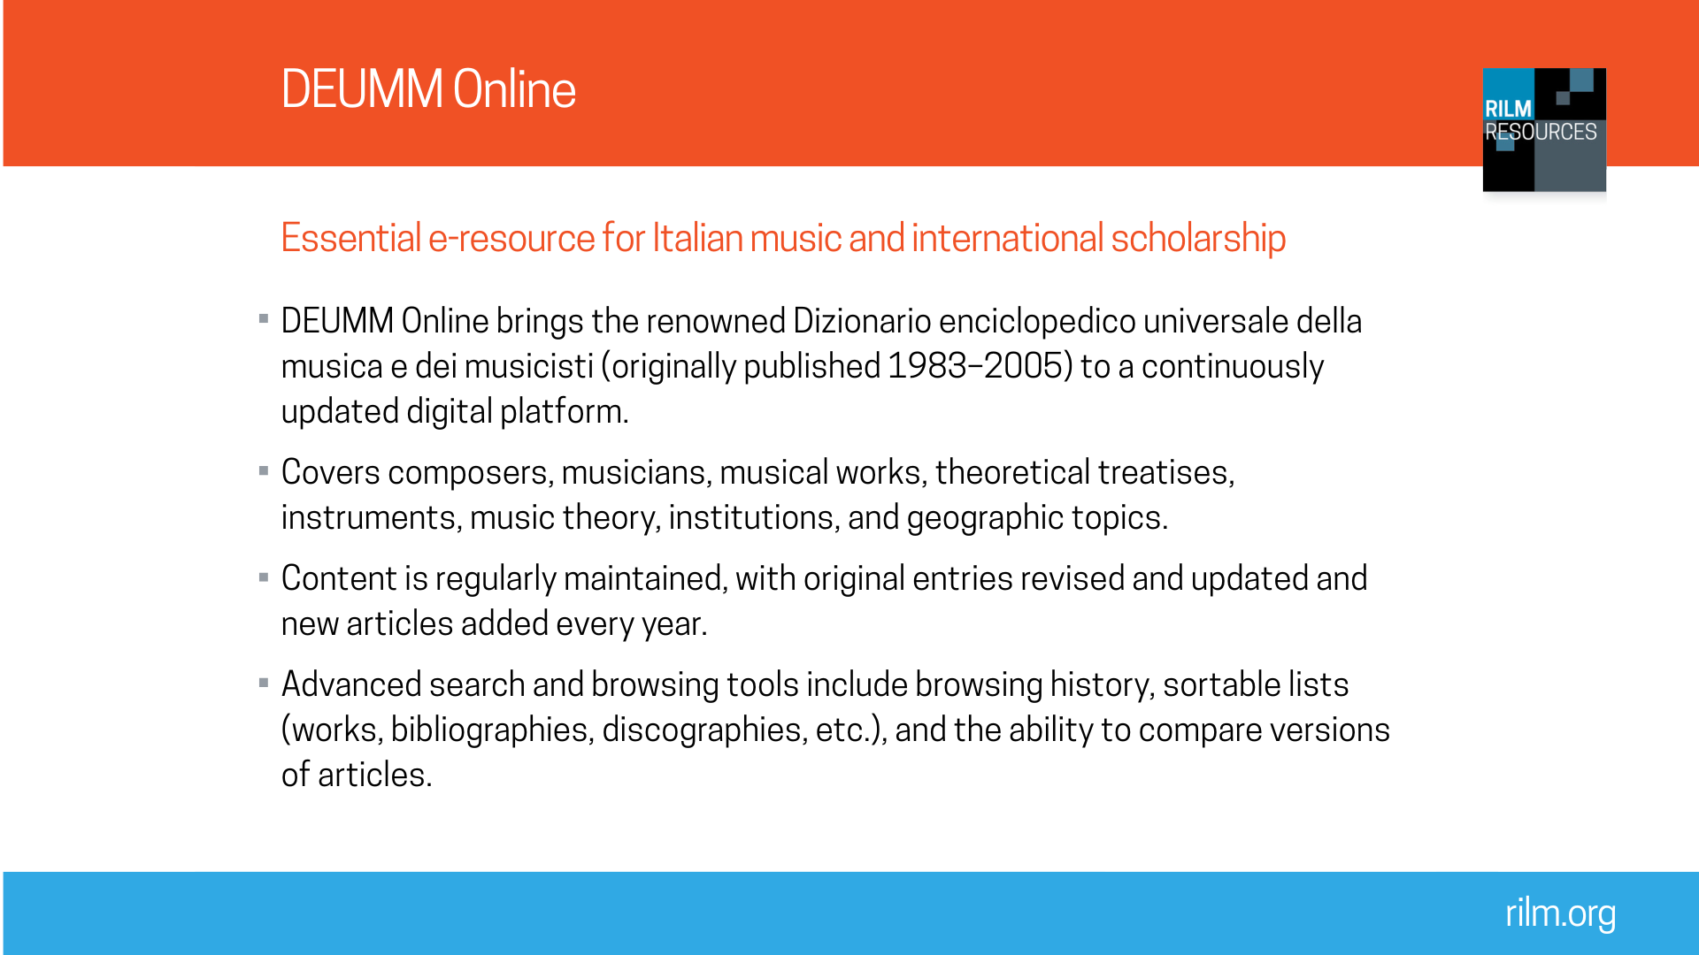

Notes:
The venerable Italian music encyclopedia Dizionario enciclopedico universale della musica e dei musicisti (DEUMM), originally published between 1983 and 2005, was launched online as DEUMM Online in October 2022. The original content from the printed volumes, edited by Alberto Basso, serves as the core of the new site.

Slide 20
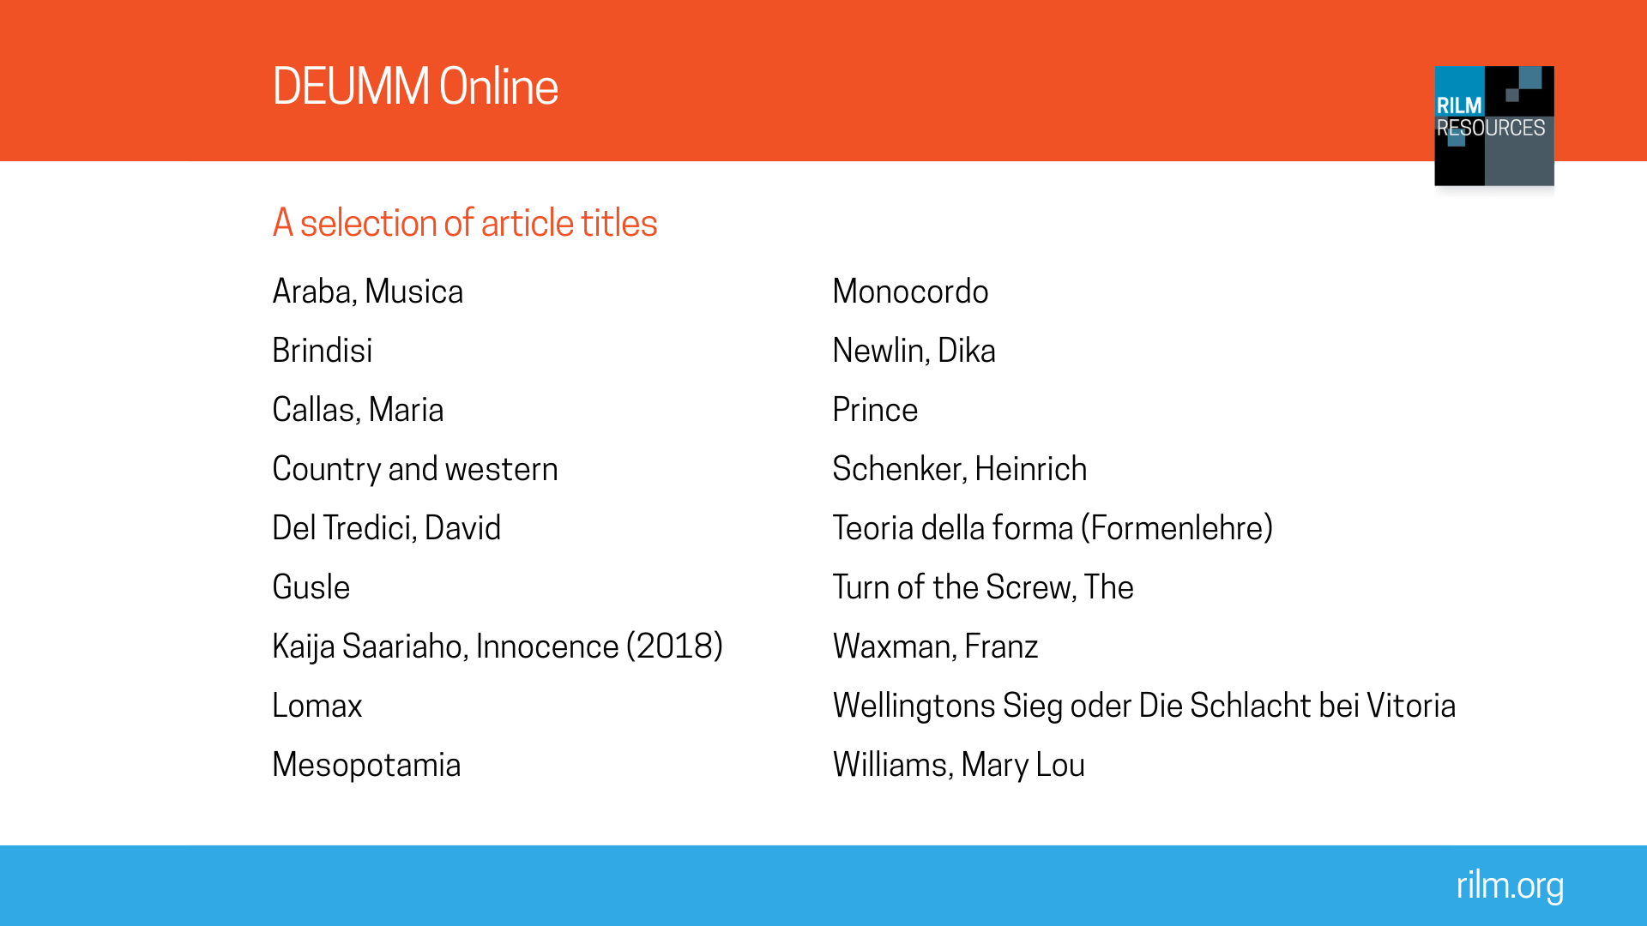
Notes:
DEUMM Online contains about 35,000 articles concerning composers and musicians, musical works (particularly stage works) and theoretical treatises, instruments, theoretical concepts, institutions, and geographic entries. Entries are continuously revised and updated, and new entries are also added. With roughly 150 new articles each year, DEUMM Online’s coverage is expanding.

Slide 21
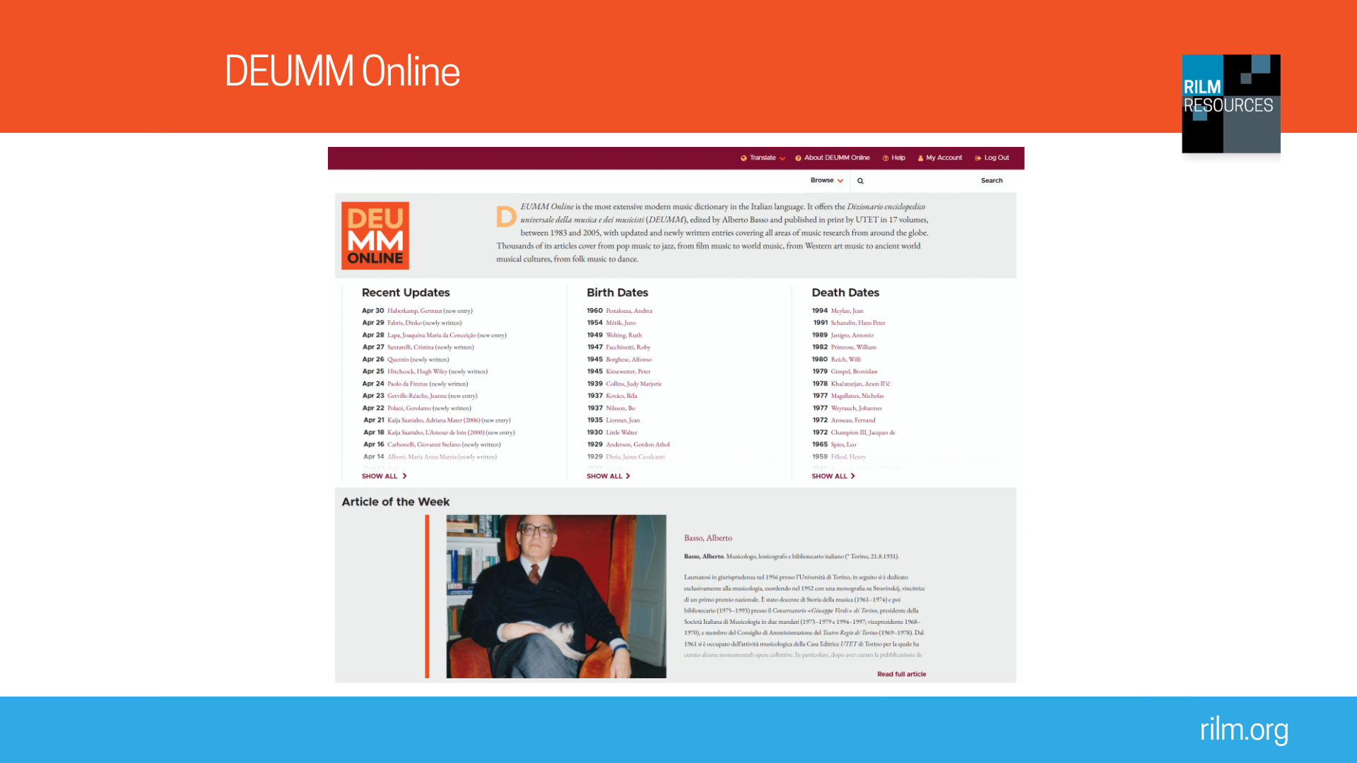
Notes:
The DEUMM Online interface is available in Italian and English versions, and individual articles can be translated in multiple languages using Google Translate, which is integrated directly in-site. Browsing can be done alphabetically by:
Title of the article
Name of the author
Nationality of the person discussed
Occupation of the person discussed
Recommended searches on deumm.org
1. Search Giuseppe Verdi. Click on the article “Verdi, Giuseppe Fortunino Francesco”.
What does this search show? This article had a major update in 2024 that can be compared with the 1988 version by simply clicking under Other Versions. The article also displays various types of link available via DEUMM Online: links to related articles in the encyclopedia and external links to other articles in RILM’s Egret products (such as RME), RILM Abstracts and to the Istituto Centrale per il Catalogo Unico (ICCU) online catalogue, which provides access to the related publications kept in the network of Italian libraries.
2. Search Anton Bruckner. Open the article “Bruckner, Anton”. Click on “Composizioni” (works) then “Musica strumentale” (instrumental music) and finally “Per orchestra” (for orchestra).
What does this search show? The work lists on composer pages in DEUMM are exceptionally detailed: As well as catalogue numbers, dates are provided for composition, first performance, and first publication. Furthermore, links are provided to related online resources. In this article, the WAB numbers (first column) are linked to entries for the related work in the Werkverzeichnis Anton Bruckner (Bruckner online thematic catalogue). Every work in the worklist is also linked to the scanned sketches in the furthest right column. DEUMM Online is the only resource that systematically displays links to all available scanned sketches in new articles about composers.
3. Search French chanson. Select the article “Canzone francese” (French song), then select the subsection entitled “Il secondo dopoguerra: la rinascita della chanson” (The post-war period: The rebirth of song).
What does this search show? This is an article added to DEUMM Online in 2026; it was not present in the print version. As well as newly written content, this article highlights a further advantage of DEUMM’s online manifestation: Every song mentioned is linked to a rendition available on YouTube. The inclusion of these links means that new articles in DEUMM not only provide written information about the topic, but also provide an anthology of related music.
4. Search Thoscanello de la musica. This is the name of a Renaissance music theory treatise by Pietro Aron. On the article with this title, click first “Storia” (history) then “Edizioni” (editions).
What does this search show? Although this important theoretical work is referenced in other music encyclopedias, including Grove and MGG, only DEUMM Online has a full article dedicated to this topic. Links are provided to all four referenced editions of the treatise (1523 to 1569) as well as to the modern edition. This article thus links scholarly contextualization—written by Bonnie Blackburn—with primary sources.
If you need customized searches for your classroom, please contact info@rilm.org.

Slide 22
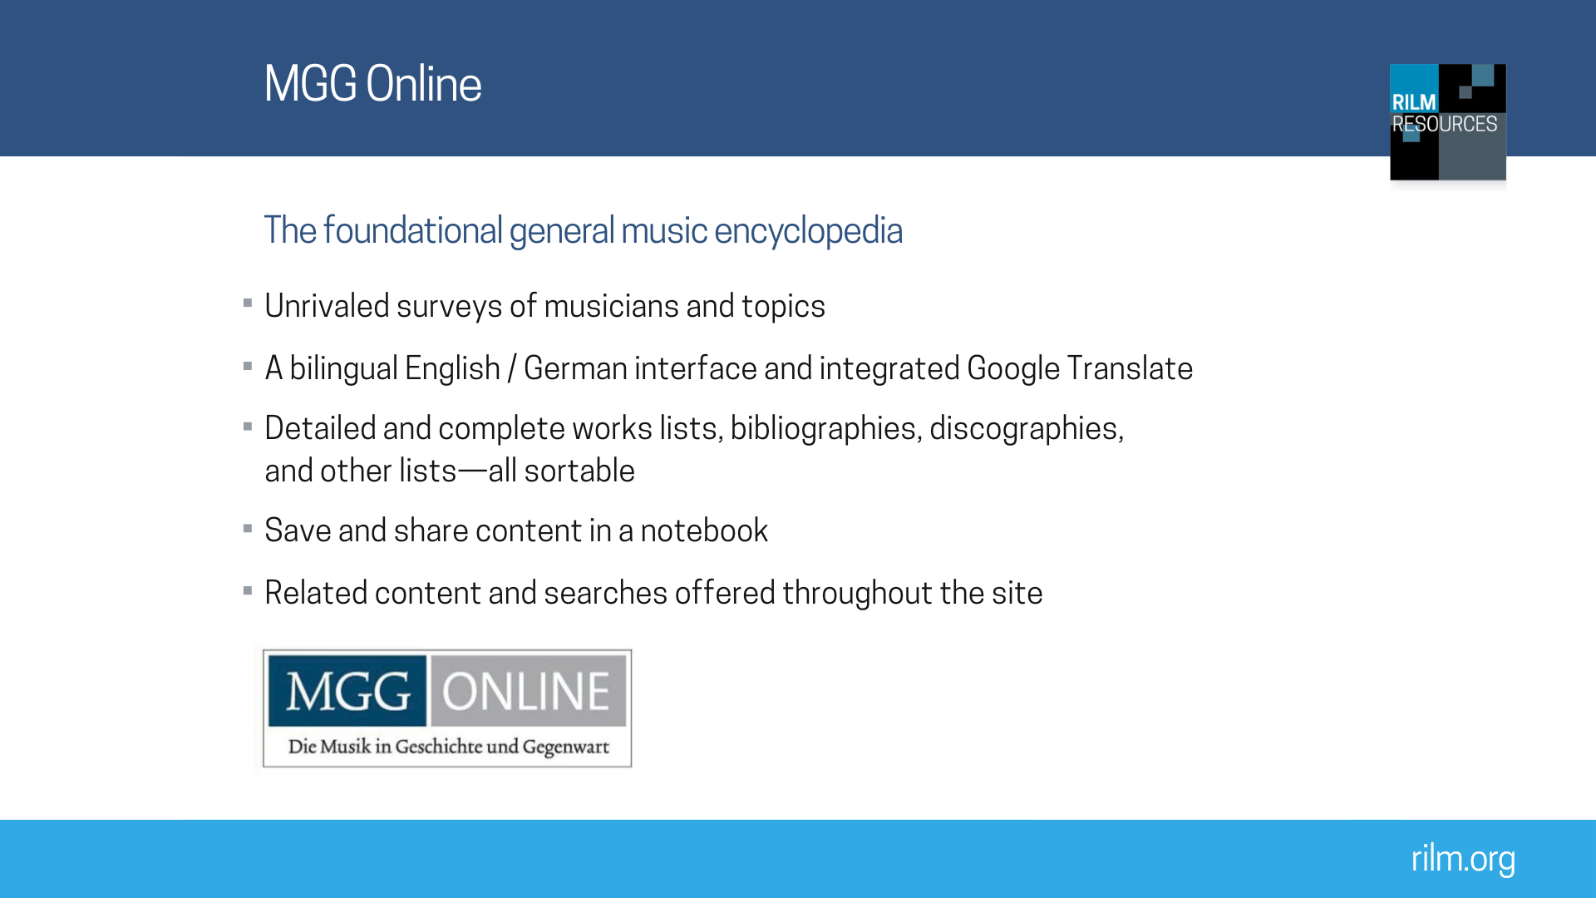
Notes:
MGG Online contains the second edition of the world-renowned German encyclopedia Die Musik in Geschichte und Gegenwart (MGG), updated and revised. In addition to the more than 19,000 articles from the second edition, the content of MGG Online is continuously updated, and revisions and entirely new articles are being added on a rolling basis, amounting to hundreds of new and updated articles by foremost experts in their fields from throughout the world. All article versions are permanently and easily accessible.

Slide 23
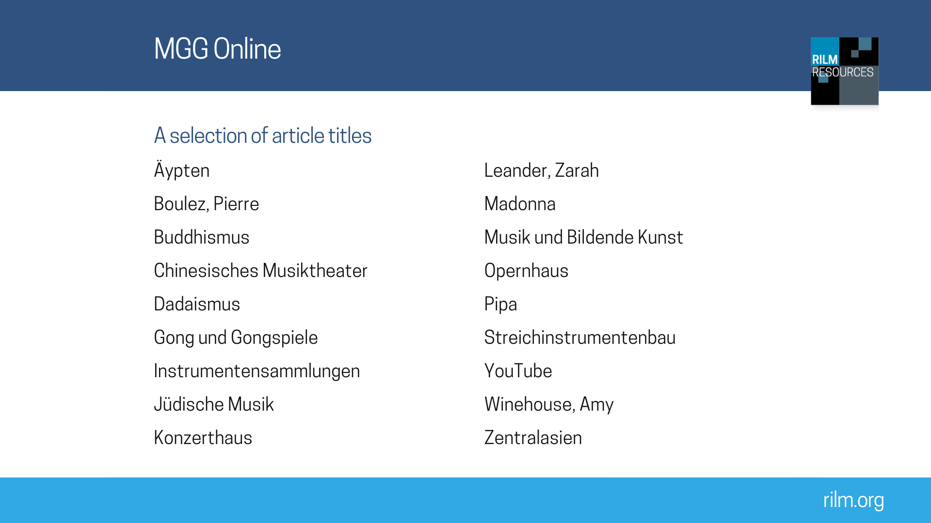
Notes:
Here is a smattering of article titles to show you the breadth of MGG Online. Go to https://www.mgg-online.com/recently-updated. This screen also gives you a sense of the updating that is going on.

Slide 24
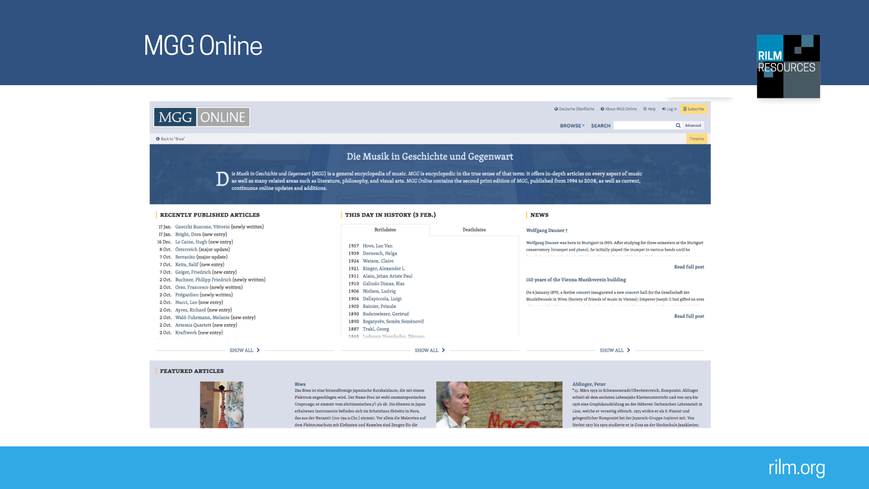
Notes:
The MGG Online interface is available in both English and German.The Translate option at the top of the page also allows for a machine translation for any page within MGG Online to be presented. As a result, you do not need to be able to read German to use MGG Online.
You can search directly from the homepage. Alternatively, press Search to get access to some more advanced search options (including searching by topic type or searching people by profession).
A timeline of people with MGG articles is also available from the homepage under the search bar. This provides another way to search for people.
Recommended searches on mgg-online.com
1. Search Franz Liszt. Click on the article “Liszt, Franz”. You can also search within the article by clicking the magnifying glass icon. You can do this in English. For example, search symphonic poem.
What does this search show? The article on Franz Liszt on the one hand shows the typical structure of articles in MGG Online on composers (biography, works, evaluation, bibliography); on the other hand, this long article shows the remarkable depth of information available.For example, the list of works is subdivided by genre and performance forces and each work is shown with three different catalogue numbers, while the literature section encompasses 580 writings on the composer, subclassified by topic.
2. Search world music. Click the article on the topic, “Weltmusik” (World music). On the left hand bar, click on part V, “World Music als Vermarktungsstrategie” (World music as marketing strategy). After looking through the page, click on the Keil/Feld link to go directly to the bibliography.
What does this search show? In comparison to the article on Liszt, this article demonstrates a thematic organization: You can see the range of topics covered in the left side. The article suggests how cultural, commercial, and institutional forces shape conceptions of world music. Part V shows how the classification of world music was used to package, promote, and sell sounds. The page’s substantial bibliography includes items in both English and German.
3. Search reggae. The results include “Reggae”, “Westindische Inseln (Karibik)” (West Indies [Caribbean]), and “Afroamerikanische Musik” (African American music). Click “Afroamerikanische Musik” then, navigating from the bar on the left of the screen, select part V1d, “Jamaica”.
What does this search show? The different results allow for different lenses on the topic—genre, geography, and the context of diasporic music. Unexpected results such as Miles Davis and Ottawa show reggae’s significance extends across genres and geographies. The article on African American Music covers music of African origin throughout the Americas, not merely in the U.S., expanding the definition of the term beyond its frequent usage in the U.S. The section on Jamaica situates reggae both within the broader history of Jamaican music and within the broader context of the African diaspora.
4. Search Miles Davis. Click on the “Davis, Miles” page. Look at the bars on the left—the contents of the page—and right of the page—including External Links and Other Publications.
What does this search show? This page features discography, transcriptions, and filmography. The links on the right demonstrate how RILM’s resources are integrated, allowing the researcher to go between different sources and forms of research seamlessly.
5. Search Pierre Boulez. On the article dedicated to the composer, click on Other Versions in the right hand bar to see previous MGG articles on the composer.
What does this search show? The ability to track revisions of the article is important for historiographical research as a means of following how thinking has evolved. As you can see, this particular article has been thoroughly revised more than once.
If you need customized searches for your classroom, please contact info@rilm.org.

